Slide 1
towards borderless
cross border cooperation
Lessons learnt from the EMR
(confirm in fact the key findings of the ULYSSES project)
Björn Koopmans
Managing Director Euregio Meuse-Rhine

Slide 2
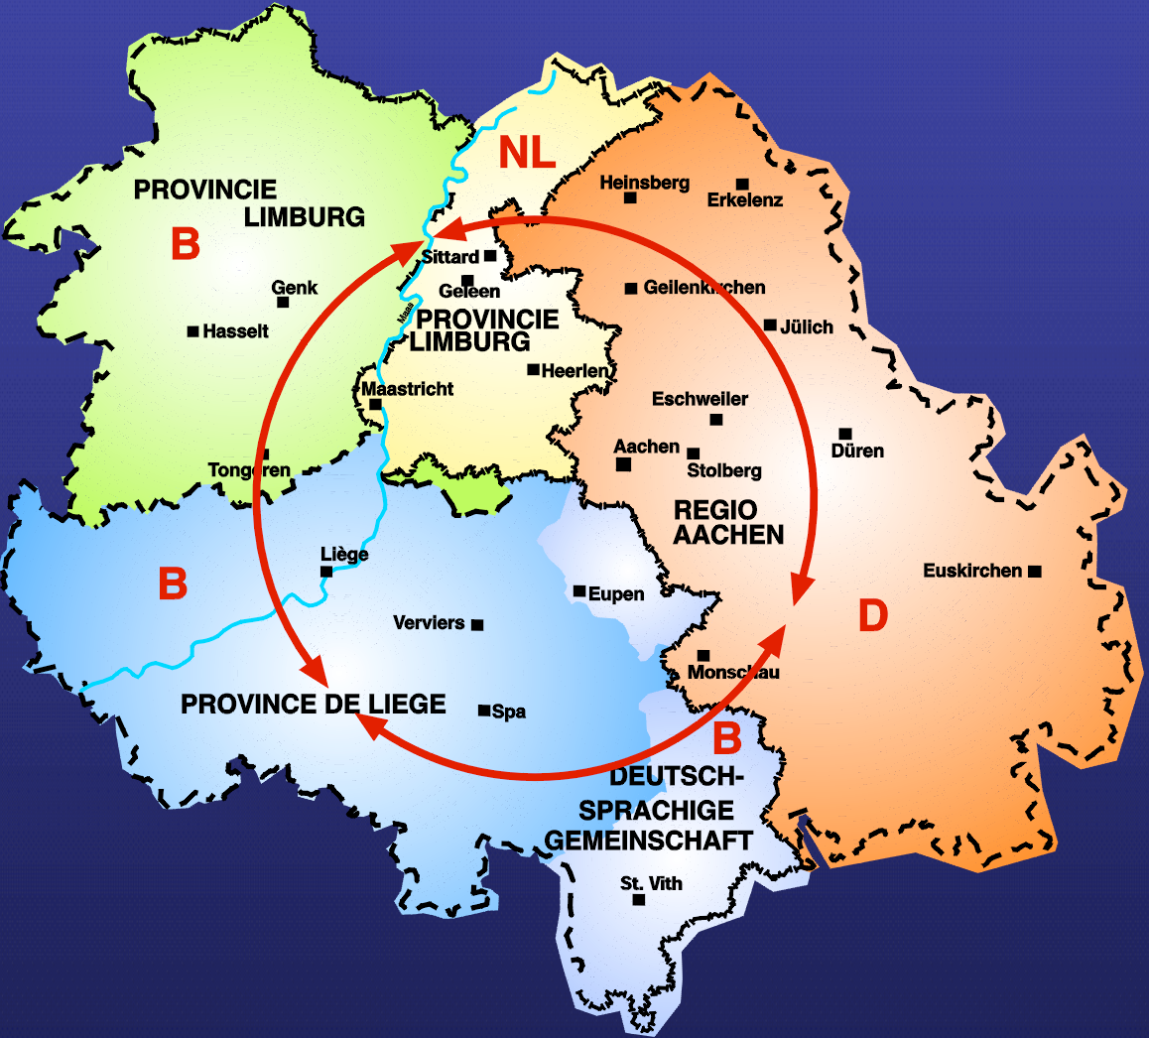
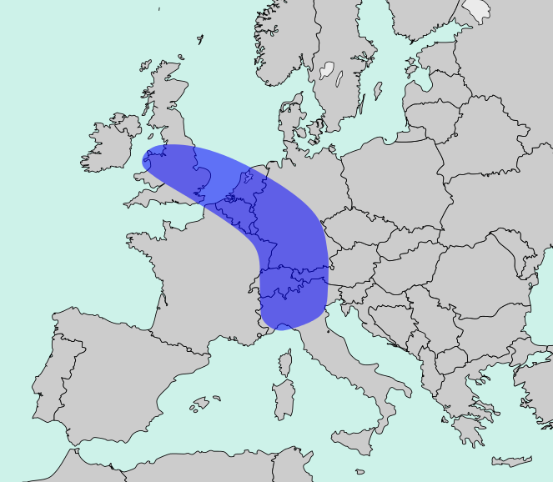
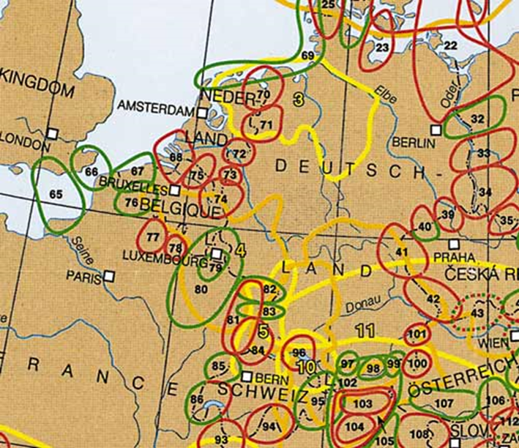
FACTS & FIGURES
Location: in the middle of Blue Banana - one of many but oldest Euroregions, pioneer Interreg
History: family of Charlemagne - since 1974 reunited in ‘Euregio Meuse-Rhine’
Geography: mini-Europe - 5 partner regions, 3 EU member states, 11000km²
Languages: mini-Babel - Dutch, French, German & Ripuarian
People: many talents - 4 million inhabitants
Economy: busy bees - 246 000 companies: 1,9 million employees and 43 000 crossborder commuters
Education & research: bright minds - 22 universities & universty colleges and 300 research companies: 128 000 students
Connections: on the move - 8 airports within 125km, 2 high speed railway stations, 3rd largest inland port
Facilities: mens sana in corpore sano -
100 hospitals and 200 musea
Organisation: both structural cooperation and management Interreg resulting in 394 projects/€ 183 mill. EU cofinancing past 25 years
Area: diverse periurban polycentric functional cross border metropolitan what?
Euregio Meuse-Rhine

Slide 3
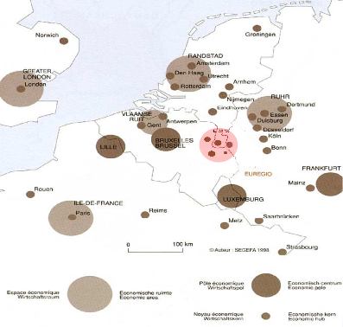
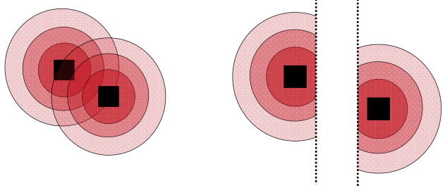
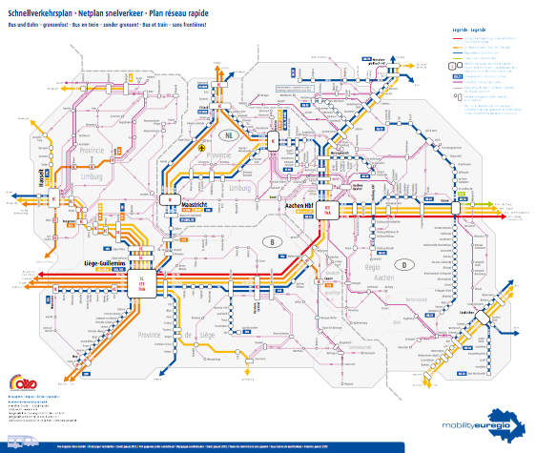
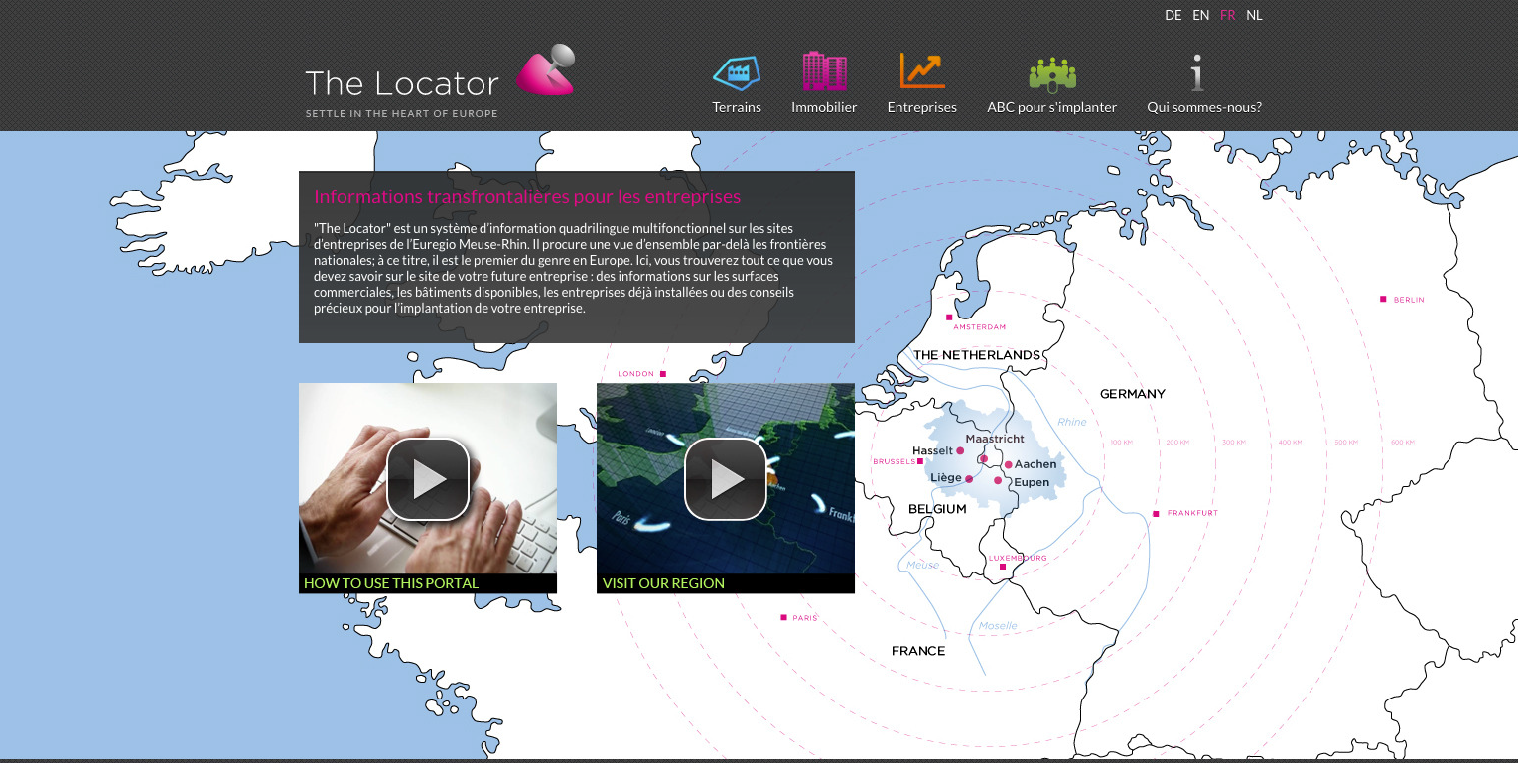
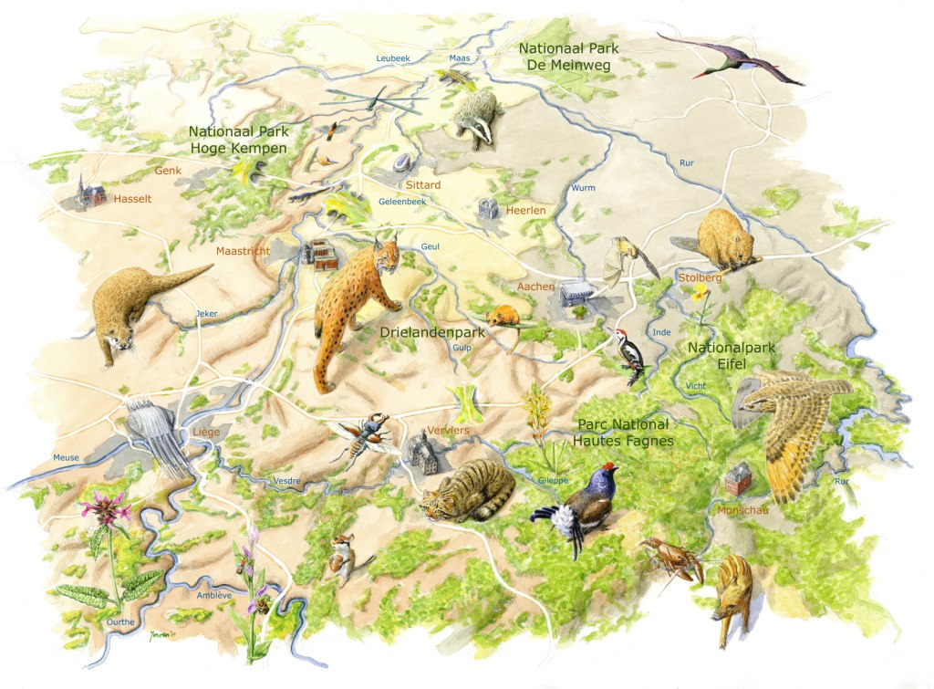
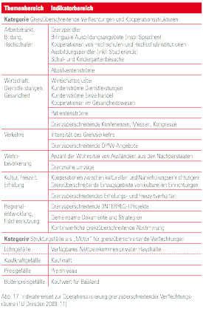
CROSS BORDER METROPOLITAN WHAT?
One concept, several definitions for a cross border area without borders
Towards borderless cross border cooperation? Rationale behind the EMR’s strategy!
1G : tackling problems => bilateral agreements
2G : ceasing opportunities => joint projects (with support of INTERREG)
3G : reaping ‘agglomeration advantages’ => common policies
(4G: completing the EU single market…)
Living up to the idea of borderlessness…more than an idea
research on ‘comparative advantages’
life sciences & other good practices of Interreg projects on landscape, mobility & business sites.

Slide 4
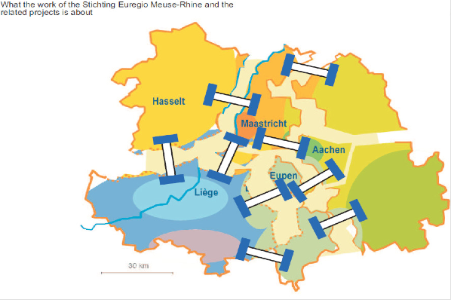
NOT TO CONCLUDE Some challenges to overcome
The quest for the shared interest & the ideal structure
Personal engagement and form follows function.
EGTC or not to EGTC, is not the question. Competence is!
Convention to be unconventional, or just pragmatic.
Border regions as barrier-o-meter for European integration
Focus on provision of (public) services to the people.
Cross border programs are programs for cross border areas?
If you look beyond EU2020, small is indeed beautiful.
P.S. Go with the flows: some cross border data would be nice.

Slide 5
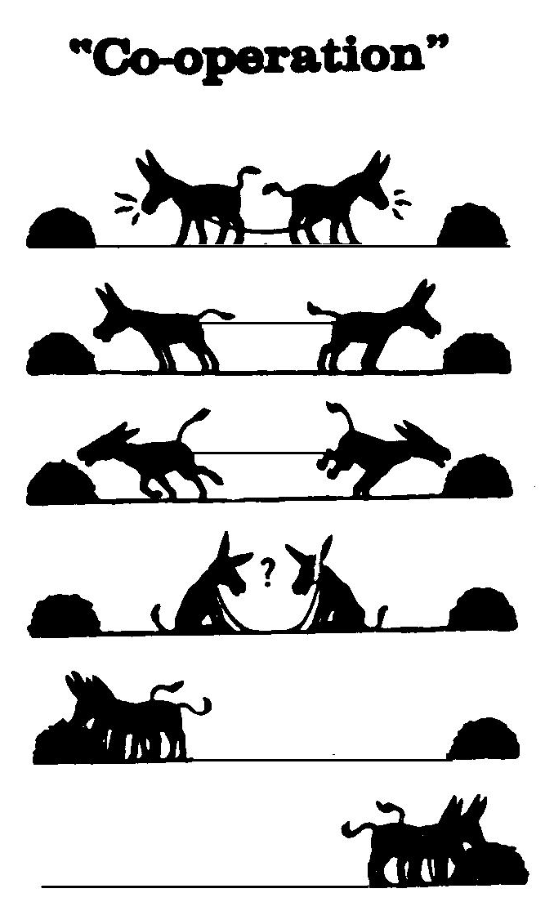
“The competition of the future is collaboration”
(Steve Wartman - President Association Academic Health Centers US)
More info about the EMR:
www.euregio-mr.eu
Interreg IV-A EMR Projects:
www.interregemr.eu
Contact:
Björn Koopmans – Managing Director
E-mail: bjornkoopmans@euregio-mr.eu
Thank you for your attention!

