Slide 1
Potentials to strengthen
Europe’s gateway cities and regions
ESPON Gateway Workshop
27 November 2013, Brussels
Dr Kai Böhme
Spatial Foresight

Slide 2
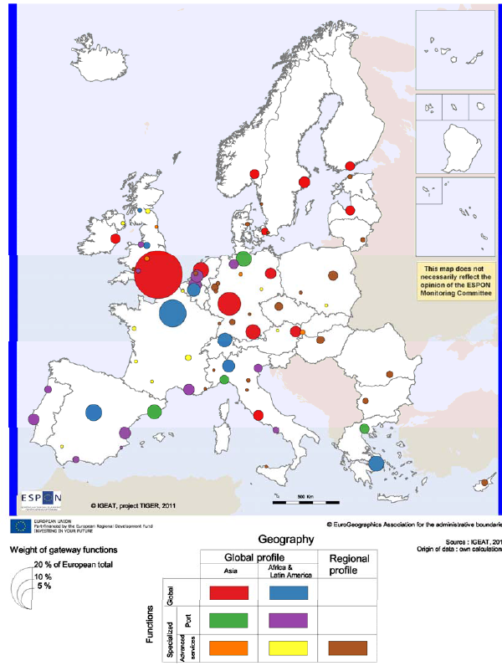
Typology of Gateways
Functions & geographical orientation
Gateways are about
… flows
… geographical reach & orientation
… functions

Slide 3
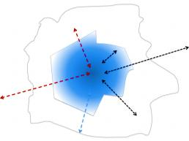
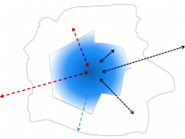


 | Global | EU | National | Regional
Economic & Business | The hotspots of advanced producer services and the main economic centres are Europe’s gateways. The financial sector and, for Europe in particular, the accountancy sector are increasing their significance and power to generate important network connections. Trade and the direction of international trade relations define the gateway profiles of Europe’s cities and regions. See sections 1 and 2.1 |  | European cities that trade mainly with other European cities show differences in the geographical orientation. The national urban system and dominance of single cities play an important role in the discussion of economic gateways. See sections 1 and 2.1 | Cities as centres for their region are not equally accessible all over Europe. General services of interest are often also concentrated in cities serving a wider area. See sections 3.1 and 3.2
Knowledge | Research and innovation hotspots which are well connected internationally and integrated into main networks play a major role for Europe’s position in the global knowledge society. Some universities function as global / international gateways for Europe. See sections 1 and 2.2 |  | Higher education as well as certain R&D functions often concentrated in the main cities of a country. Not discussed in this report | Regional centres often serve as gateways for education and health care going beyond the basic level. See section 3.2
Transport | Europe’s large international airports and ports are crucial gateways for the global transport of goods and people. In a European perspective rail and road and secondary airports and ports also perform important gateway functions. See section 2.3 |  | All modes of transport connections to cities in neighbouring countries but also in their own country. See section 3.1 with special focus on regional airports | The accessibility to the nearest gateway (city or entrance point to a major network) shows the regional dimension of gateways. See section 3.1
Human Attraction | The attractiveness of cities and regions influences the gateway function when it comes to receiving flows of people. Inward migration, exchange students, and the number of international visitors (tourists) give an indication of the importance of this gateway function. See section 2.4 |  | Domestic tourists are an indicator of the national gateway function as regards human attraction. See section 2.4 | Intra-regional migration or tourism to regional centres would underline its regional gateway function Not discussed in this report
Economic and business gateways – global to regional
Knowledge gateways – global to regional
Transport gateways – global to regional
Attraction gateways – global to regional

Slide 4

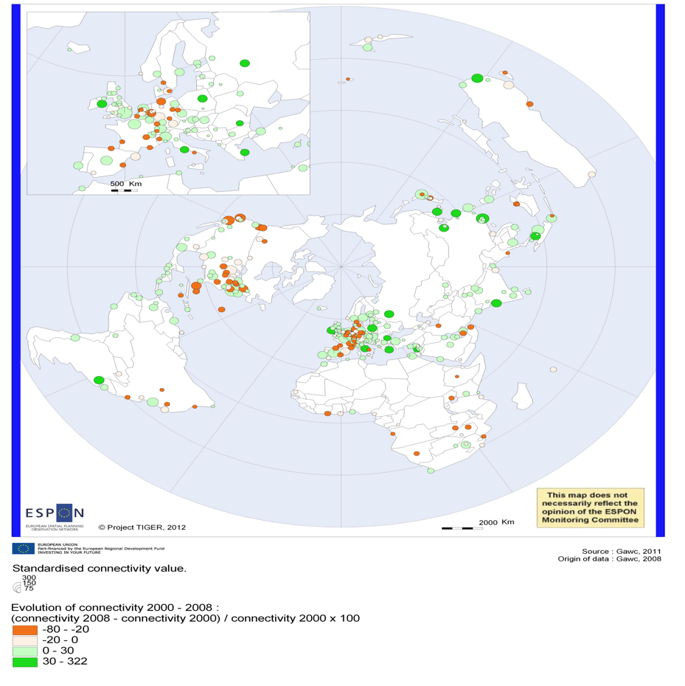
Economic & Business Gateways
Cities connectivity in advanced producer services and its evolution between 2000 and 2008
London – Europe’s only global business gateway
Chinese & Indian gateways next
In Europe Dublin, Rome, Bucharest and Warsaw increase network connectivity
Accountancy important factor in Europe
European cities still can improve their global position
accountancy, advertising, banking, law

Slide 5

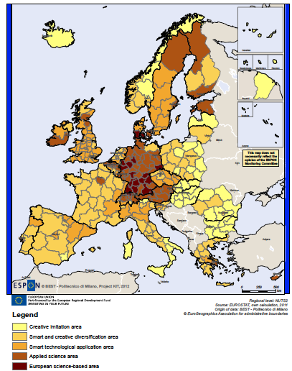
Knowledge Gateways
Territorial patterns of innovation
Research centres as gateways in knowledge and science networks
European core hosts most gateways
Smart technological application areas – translating science into innovation (Northern Italy, UK, Sweden)

Slide 6

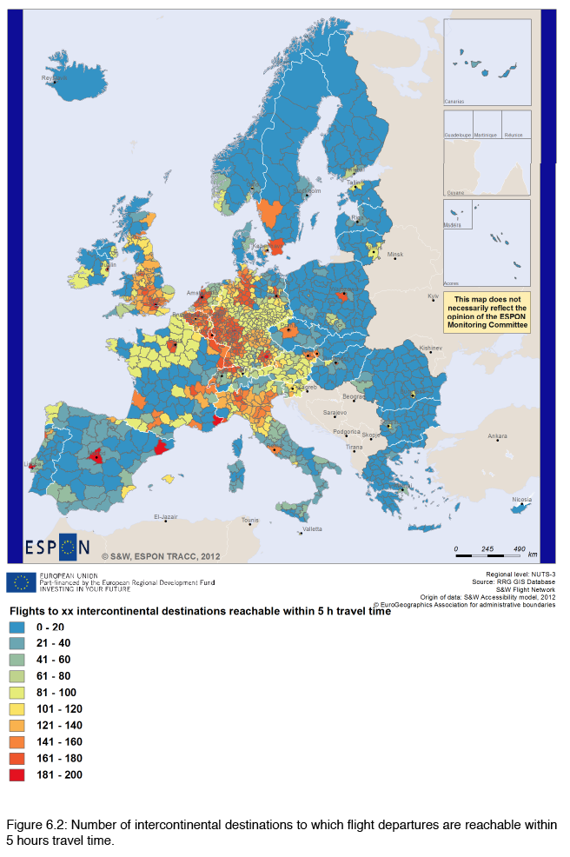
Transport Gateways
Flights to intercontinental destinations reachable within 5h time, 2012
Global hubs concentrated in the European core
Airports of major urban areas as important hubs
Exceptions: e.g. Athens, Sofia, Bucharest and Stockholm are no global hubs
Different geographical orientation

Slide 7

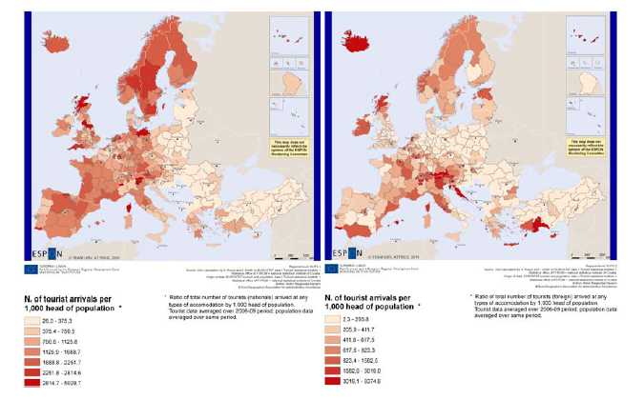
Attraction Gateways
National and foreign tourists per 1,000 inhabitants, 2006-2009
International tourism: major cities, Mediterranean & Alps
Domestic tourism:
rural and coastal areas
Migration:
cities
different types of migratnts

Slide 8
National & Regional Gateways
Gateway & its hinterland as symbiosis
Smaller cities matter

Slide 9
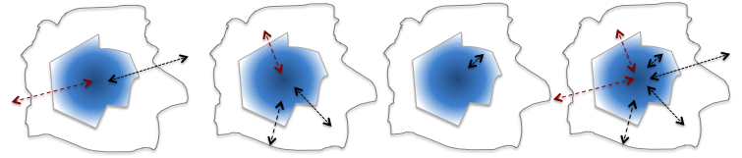
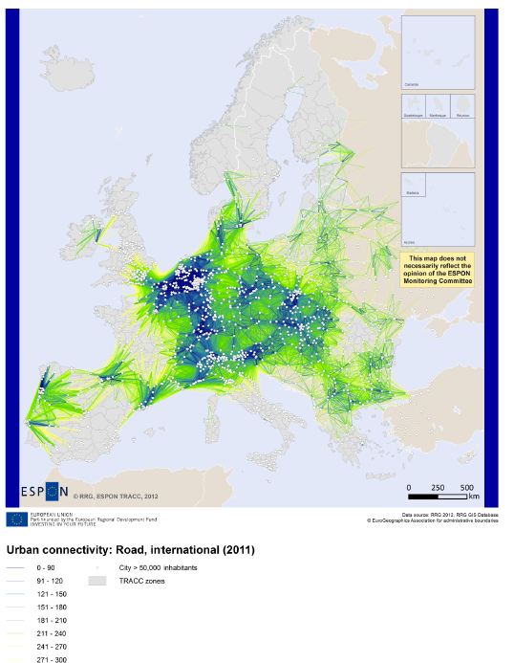
Transport
Urban connectivity, 2011
Cities and entrance points to major transport networks
City networks &
links with neighbouring countries
Benelux cities well networked
Atlantic rim strong on freight hubs

Slide 10
Transport
Airports – number of destinations, 2011
Regional airports as important regional hubs
Fragile systems
Airport profitability vs. role for regional economy

Slide 11
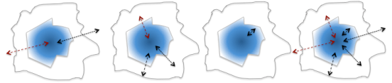
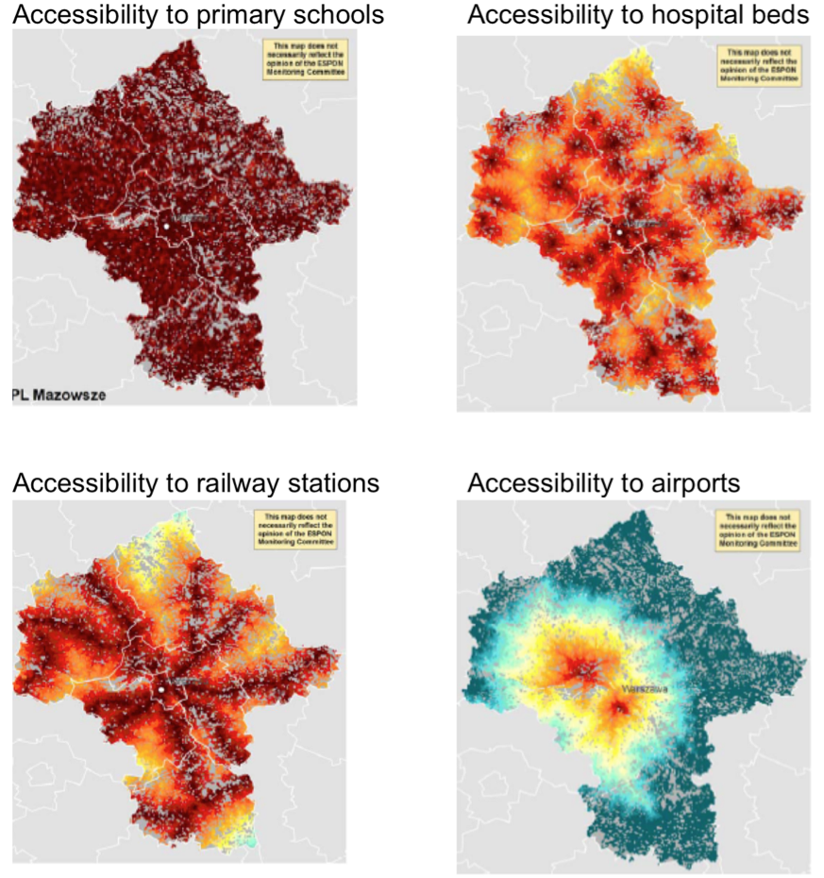
Services of General Interest
Gateways to services of general interest in Mazowsze (Poland)
Access to services of general interest – a matter of scales
Highly specialised services concentrated in urban hubs
Frequently services with local or sub-local centres

Slide 12
Key findings
London rules. Within Europe, London is pre-eminent across a wide range of gateway functions.
Concentration of gateway functions in the European core. In Europe Global transport hubs and economic gateway functions are often highly concentrated in this part of Europe.
Metropolitan areas are key gateways across Europe. This applies not only to capital cities but also to larger second tier cities.
Smaller cities matter a great deal. Even some smaller cities are important gateways.
The hinterland-connection. To act as a gateway a city or region needs not only external connections but a wider hinterland.

Slide 13
Possible policy considerations
Potentials to strengthen European gateways. Gateways develop based on particular advantages deriving from an area’s geographical position and the historic legacy.
Strengthen profiles. By identifying its comparative advantage a city or region can develop a stronger profile.
Tighten networks by supporting key actors in strengthening their cooperation bonds.
Improve infrastructure. Adequate infrastructure is crucial for the development of gateways.
Support hinterland links. Strengthening the role the hinterland has for the development of a gateway function can help the development of a gateway.
Be specific. The choice of the strategy for a policy centred on a gateway depends on the expected output.

Slide 14
Questions ?
Dr. Kai Böhme
Spatial Foresight GmbH
+352 691 87 32 49
kai.boehme@spatialforesight.eu
www.spatialforesight.eu

