Slide 1
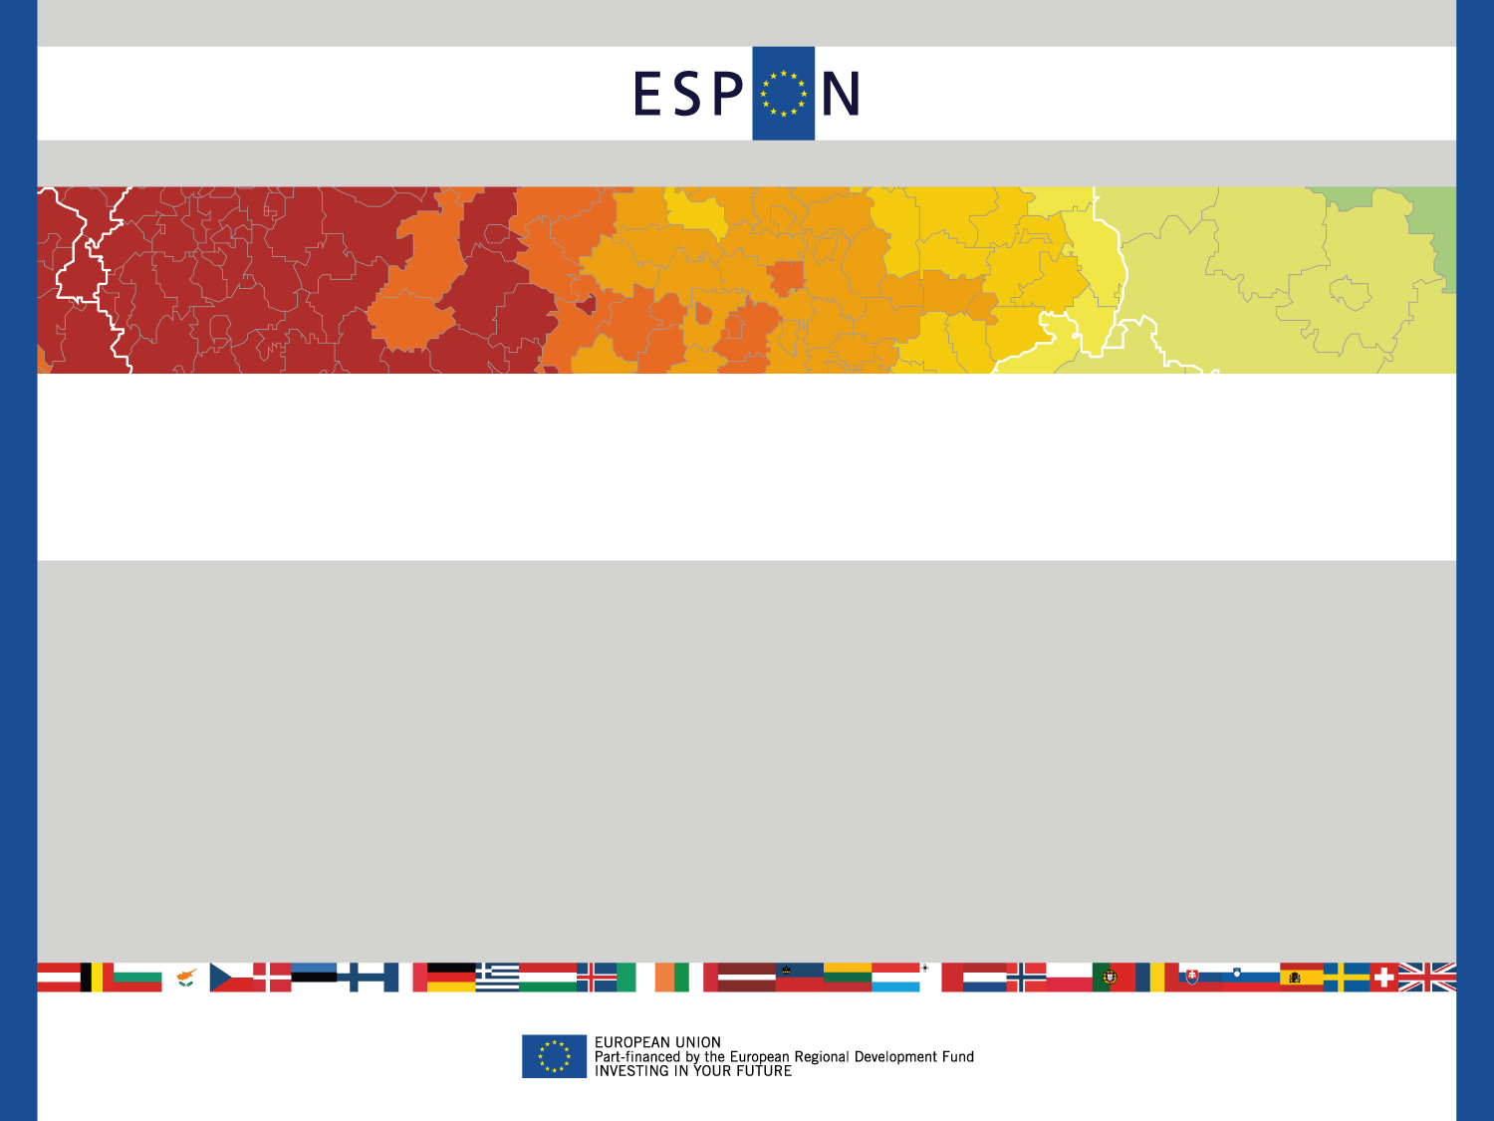
Klaus Spiekermann
Accessibility: part of a recovery?
How to make regions and cities more resilient to economic crisis
Workshop at the Open Days
ESPON 2013 Programme
8 October 2013, Brussels, Belgium

Slide 2

Accessibility and spatial development
Good accessibility of European regions improve
their competitive position but also the
competitiveness of Europe as a whole”
(ESDP, 1999)
“Providing services and minimising infrastructure barriers can improve competitiveness, and the sustainable and harmonious territorial development of the European Union.“
Territorial Agenda 2020 (2011)

Slide 3
Accessibility and spatial development
Underlying hypothesis
The important role of transport infrastructure (i.e. networks and transport services) for spatial development in its most simplified form implies that areas with better access to the locations of input materials and markets will, ceteris paribus, be more productive, more competitive and hence more successful than more remote and isolated areas

Slide 4
Accessibility
main 'product' of a transport system for spatial development
determines the locational advantage of an area (i.e. in ESPON a region, a city or a corridor) relative to all areas
indicators of accessibility measure the benefits households and firms in an area enjoy from the existence and use of the transport infrastructure relevant for their area.

Slide 5
TRACC set of accessibility indicators
Spatial Context (destination) | Basic characteristics | Generic type of accessibility indicator
 |  | Travel cost | Cumulated opportunities | Potential
Global | Travel | Access to global cities | Global travel connectivity | Global potential accessibility travel
 | Freight | Access to global freight hubs | Global freight connectivity | Global potential accessibility freight
Europe | Travel (traditional) | Access to top ten MEGAs | European daily accessibility travel | European potential accessibility travel
 | Travel (new) | Travel speed | Urban connectivity | European potential acc. intermodal travel
 | Freight | Access to nearest maritime ports | European daily accessibility freight | European potential accessibility freight
Regional | Travel (Europe-wide) | Access to high-level transport infrastructure | Availability of urban functions | National potential accessibility travell
 | Freight (Europe-wide) | Access to freight terminals | Availability of freight terminals | National potential accessibility freight
 | Travel (case studies, tradit.) | Access to regional centres | Daily accessibility of jobs | Regional potential accessibility
 | Travel (case studies, to SIG) | Access to health care facilities | Availability of secondary schools | Potential accessibility to basic health care

Slide 6
Accessibility indicators used for analysis

Slide 7
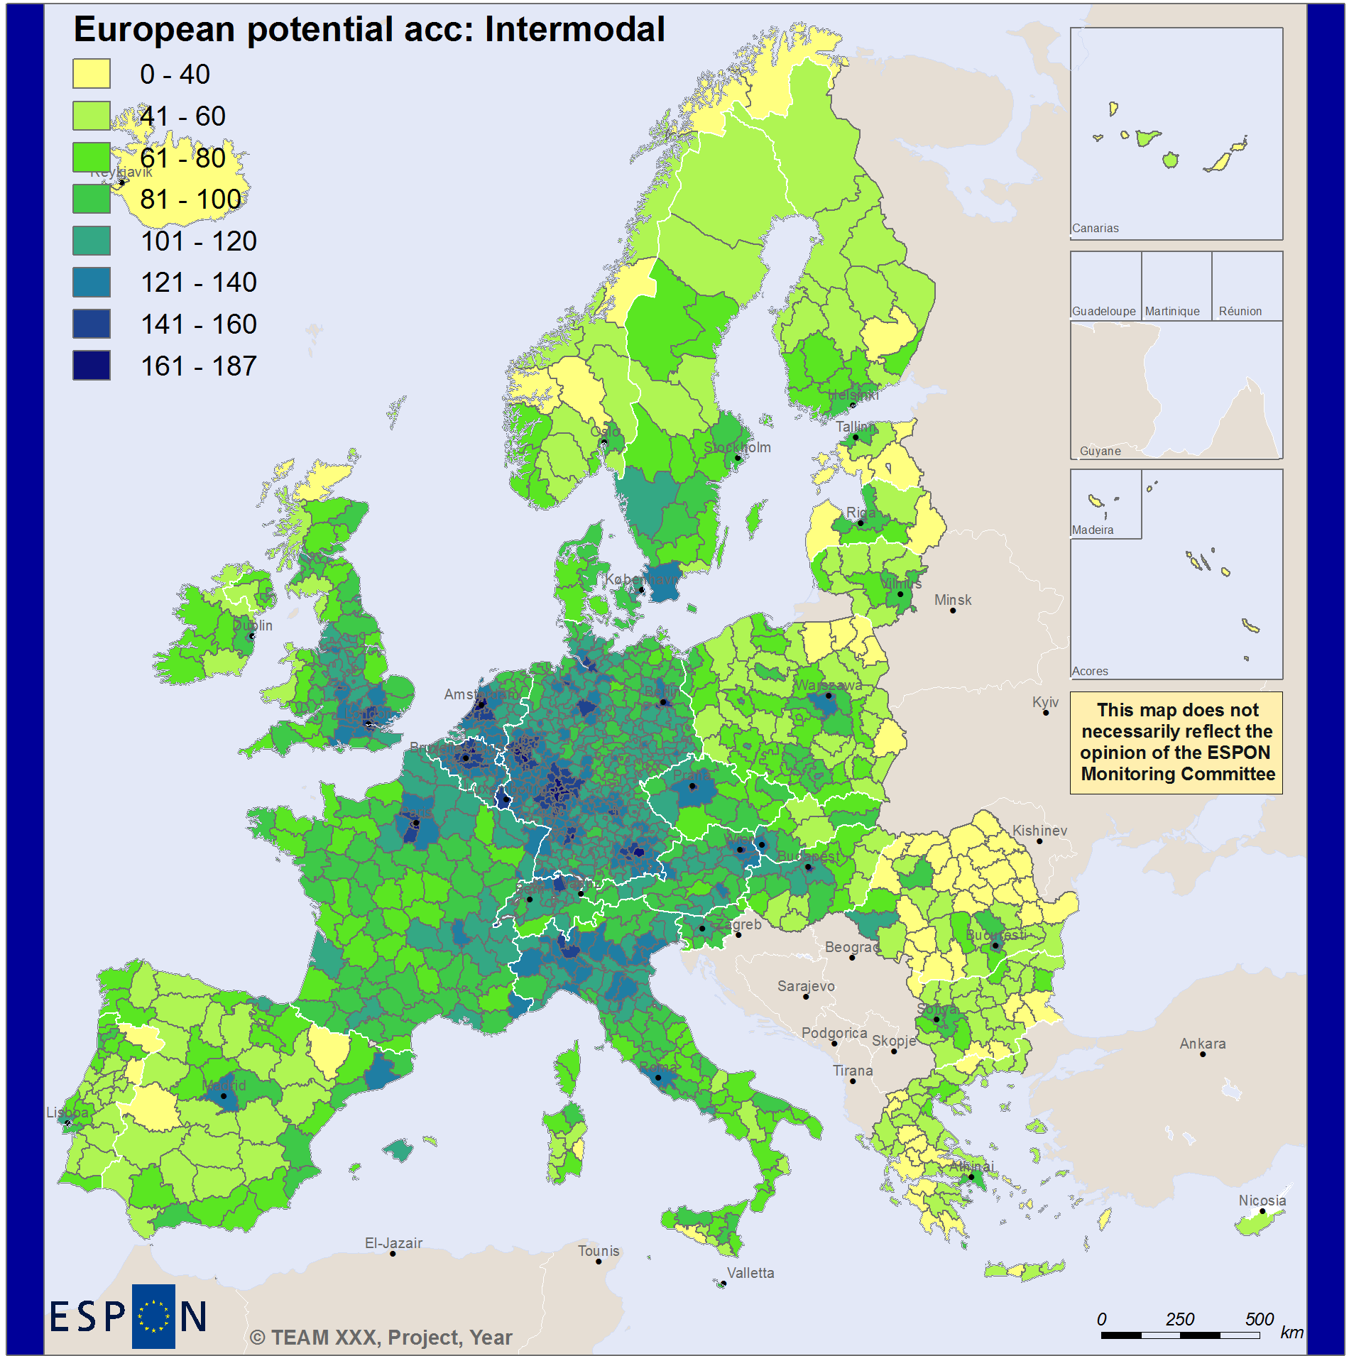

European potential accessibiity intermodal
(ESPON space = 100)

Slide 8
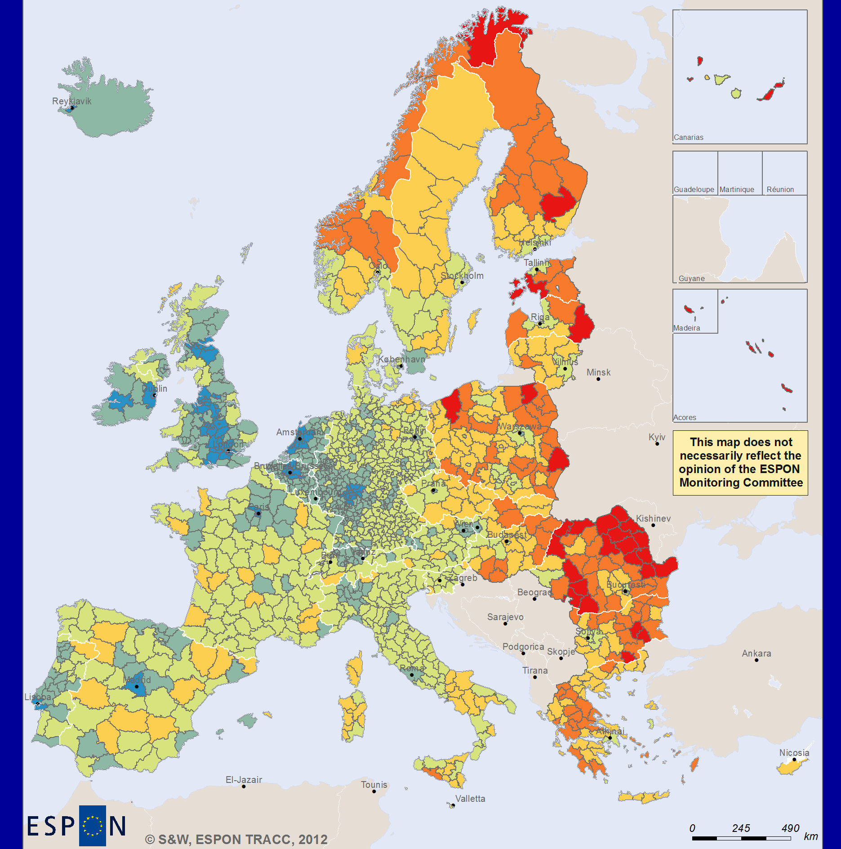
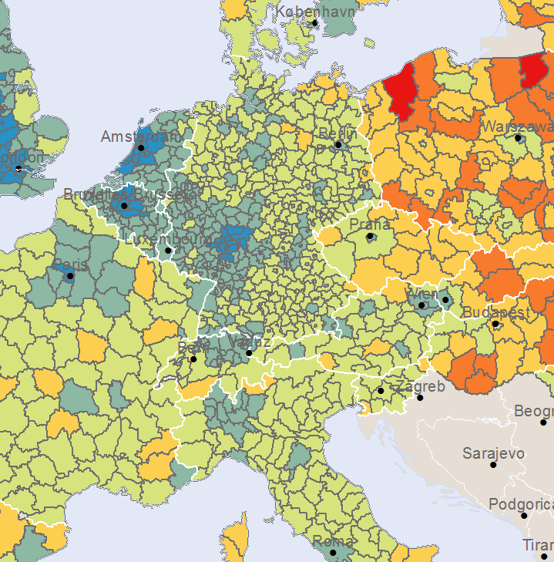
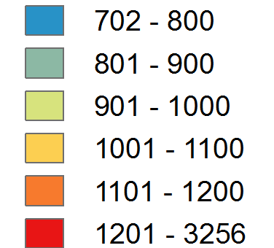
Travel time to New York
Intermodal
Minutes

Slide 9
Accessibility,
regional economic performance
and the crisis

Slide 10
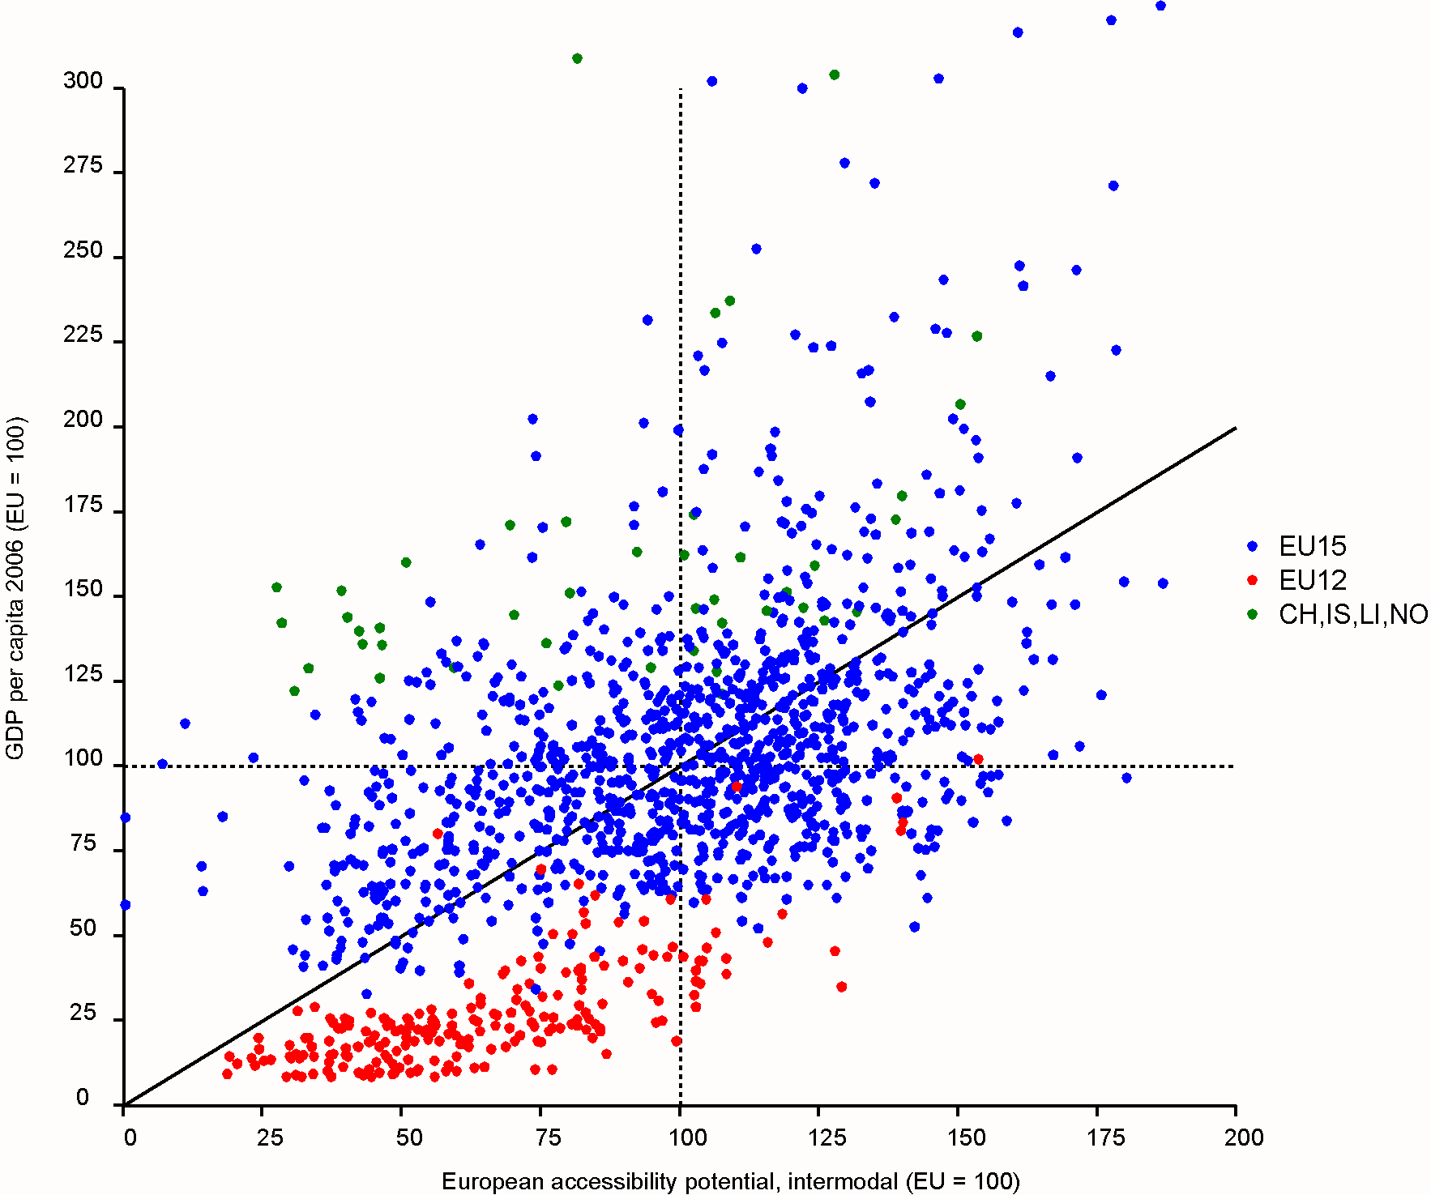
Accessibility and regional economic performance
MEGAs
Northern Europe
Southern Europe
Eastern Europe

Slide 11
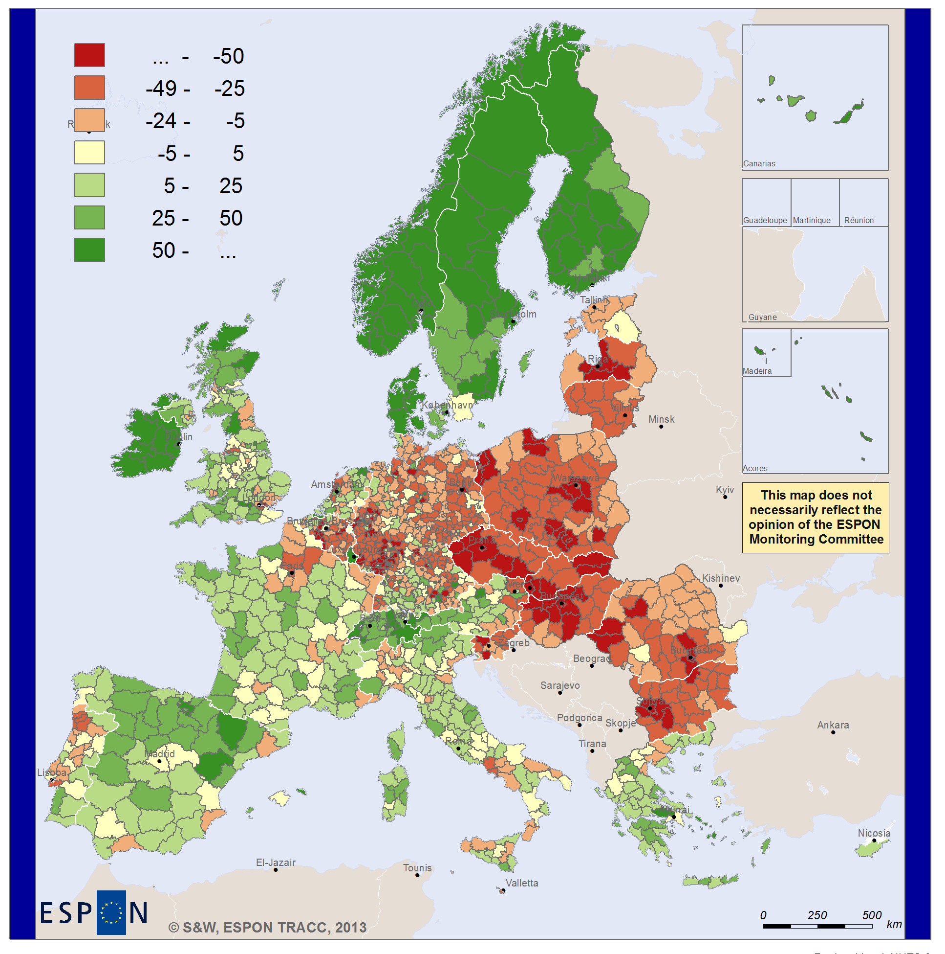
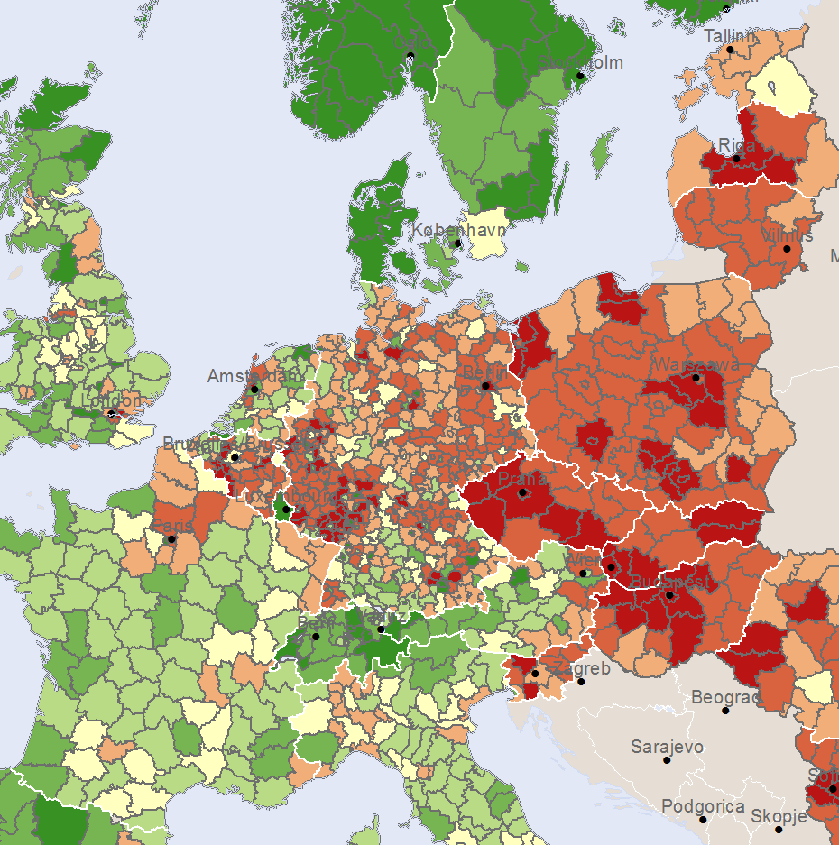
GDP/capita (EU27=100) minus
Acc potential
Intermodal
(EU27=100)

Slide 12
Accessibility and economic crisis and recovery

Slide 13
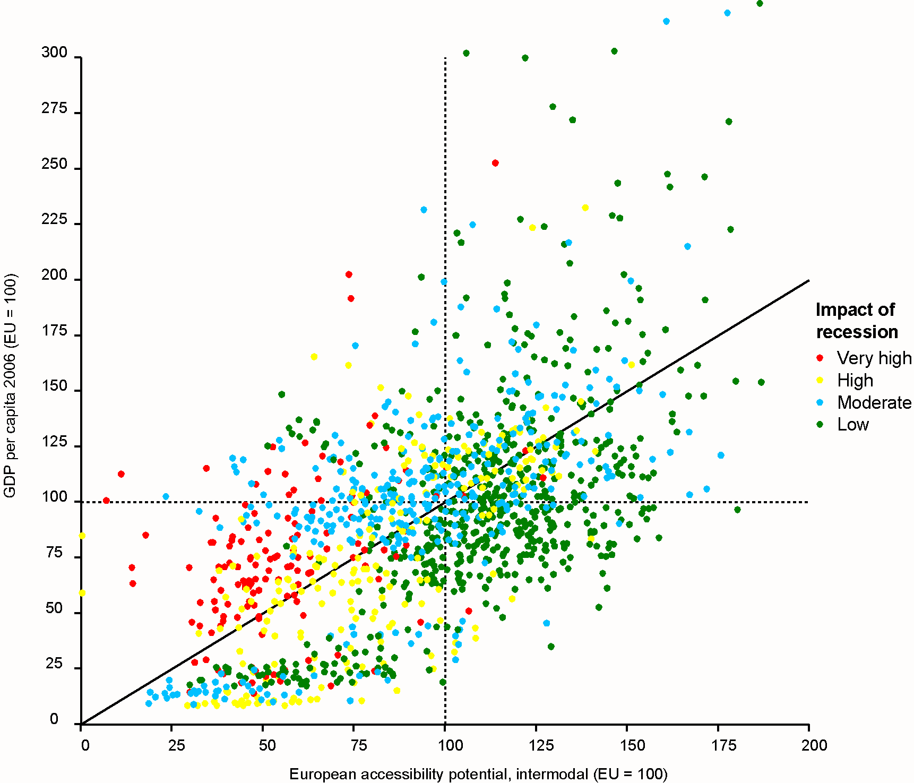
Accessibility and regional economic performance

Slide 14
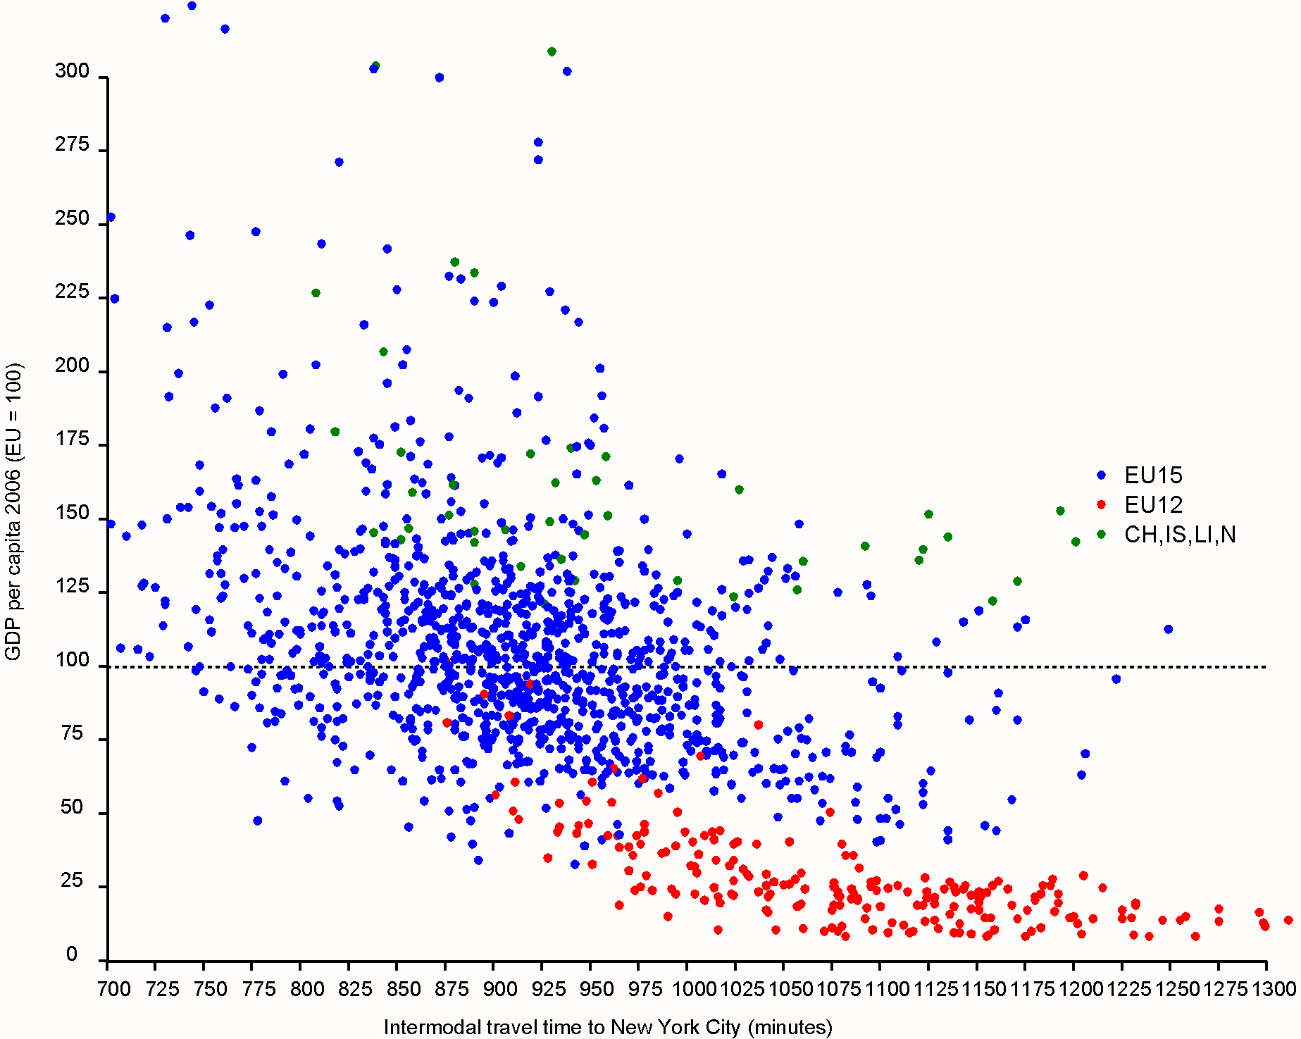
Travel time to New York City and reg. econ. performance

Slide 15
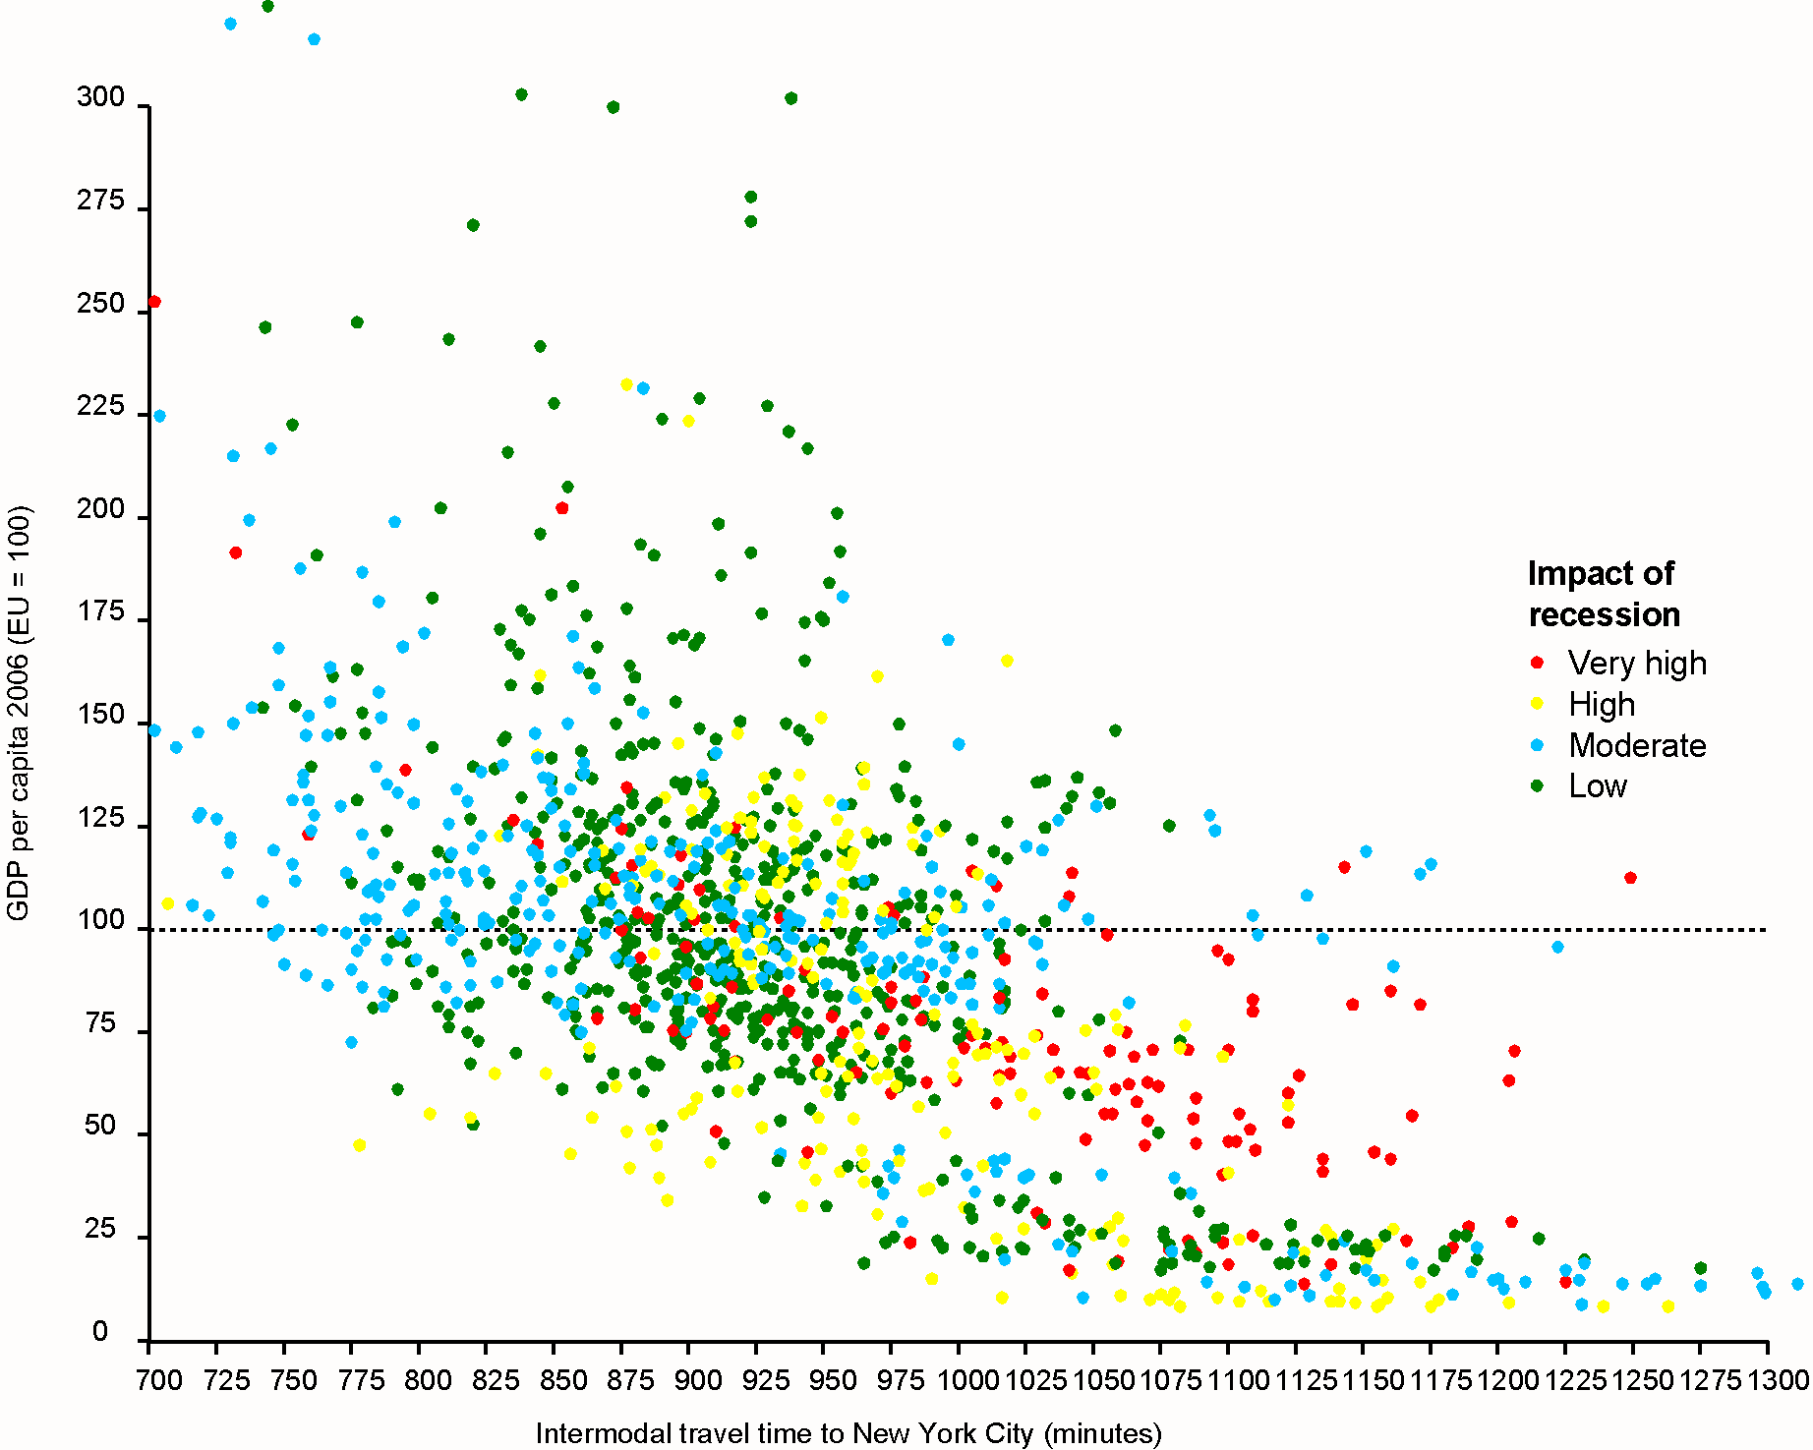
Travel time to New York City and reg. econ. performance

Slide 16
Conclusions

Slide 17
Conclusions
Spatial disparities in accessibility continue to exist for all modes of transport as well as for intermodal trip chains.
Core-periphery pattern is complex overlay of national and European patterns
Transport infrastructure and service development can change the overall European pattern only in a long-term perspective (in particular investments in high-speed rail)
Connectivity to global markets from smaller urban areas, rural areas and many regions in the new member states is clearly behind that of MEGAs.

Slide 18
Conclusions (2)
Clear relationship between accessibility and economic performance does exist, but many exemptions of underperforming (e.g. regions in Eastern Europe) and overperforming regions (e.g. regions in Northern Europe).
This clearly points to the existence of other assets by which a region might overcome poor accessibility ...
… and to the existence of deficits and barriers by which a region might not utilise its locational potential.

Slide 19
Conclusions (3)
In tendency, the economic crisis has more strongly affected regions with lower accessibility. Several of those regions are underperfoming (regions in eastern Europe), but several are overperforming (regions in southern Europe).
Most of strongly affected regions do have poorer accessibility to global markets.
On the other hand, there is a large number of regions with low accessibility that were not seriously hit by the crisis.
Accessibility and its improvement might be part of the recovery, but only in integrated packages that take account of regional assets and barriers to development.

Slide 20
Further Information
www.espon.eu
  -> TRACC project
Dr.-Ing. Klaus Spiekermann
Spiekermann & Wegener,
Urban and Regional Research (S&W)
Dortmund, Germany
ks@spiekermann-wegener.de
www.spiekermann-wegener.de

