Slide 1

European gateway cities and regions
New evidence on different types of gateways and their future role
ESPON workshop
Brussels, November 27th, 2013
Adriana May
Head of territorial cooperation Department
Regione Lombardia - D.G. Territorio, Urbanistica e Difesa del suolo
U.O. Programmazione Territoriale e Urbanistica

Slide 2


CONTENTS
• The Lombardy in the Europe Area
Gateway geographicals and meta gateways
Examples: driving innovation
  A geographical gateway: Malpensa Area Regional Territorial Plan
  Share know how: The experience of the prevention of the hydrogeological risk
  Promote innovation - the States General of the Research
Cooperazione Territoriale Europea

Slide 3
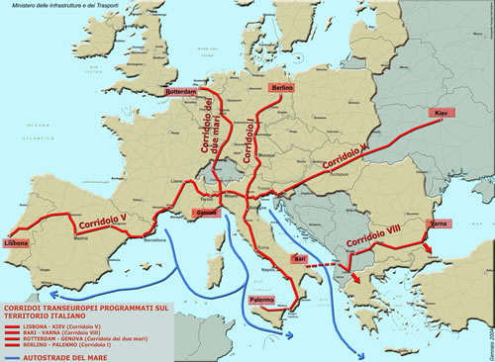
LOMBARDY AS CROSSING OF TRANS-EUROPEAN CORRIDORS
Cooperazione Territoriale Europea

Slide 4
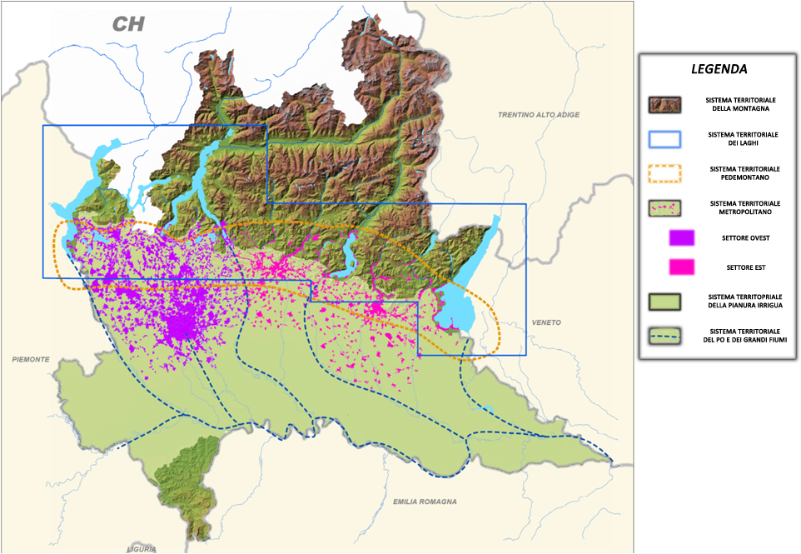
TERRITORIAL SYSTEMS
Cooperazione Territoriale Europea

Slide 5
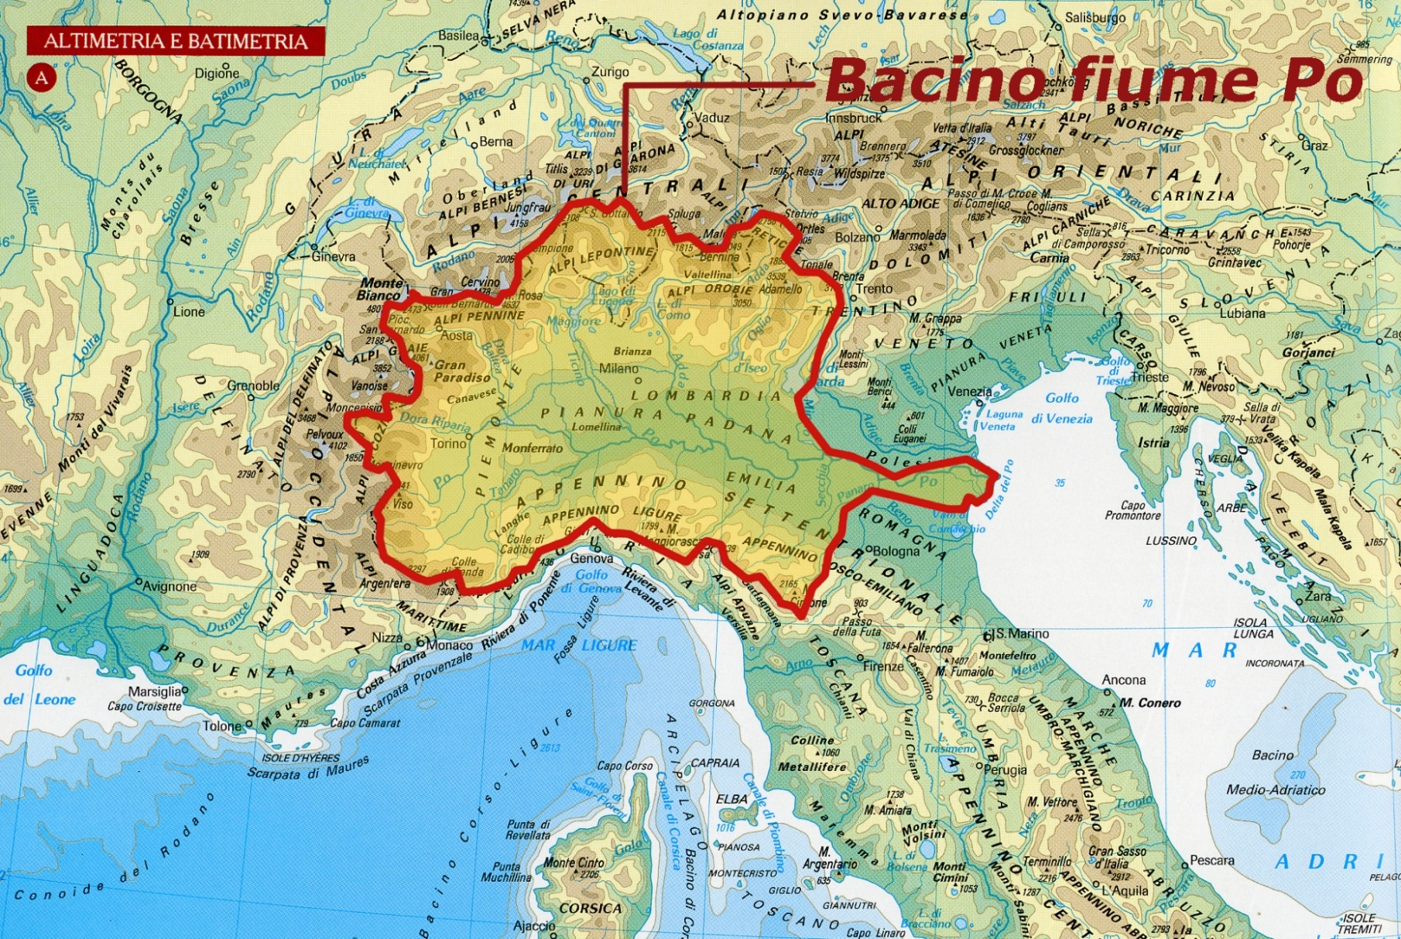
Bacino fiume Po
Cooperazione Territoriale Europea

Slide 6
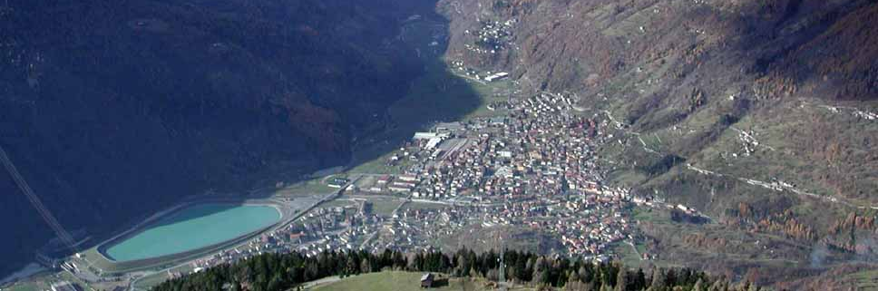
REGIONAL TERRITORIAL PLANNING SYSTEM
P.T.R. Regional Territorial Plan
Targeting system→ as a synthesis of the needs and aspirations of the territory
Guidelines for the territorial transformations → to promote sustainable development and make the best out of the opportunities
Discipline landscape → to protect and raise the territory’s value
Operational instruments → to implement the action lines
(PTRA) Territorial Regional Area Plan → performing change governance
Cooperazione Territoriale Europea

Slide 7
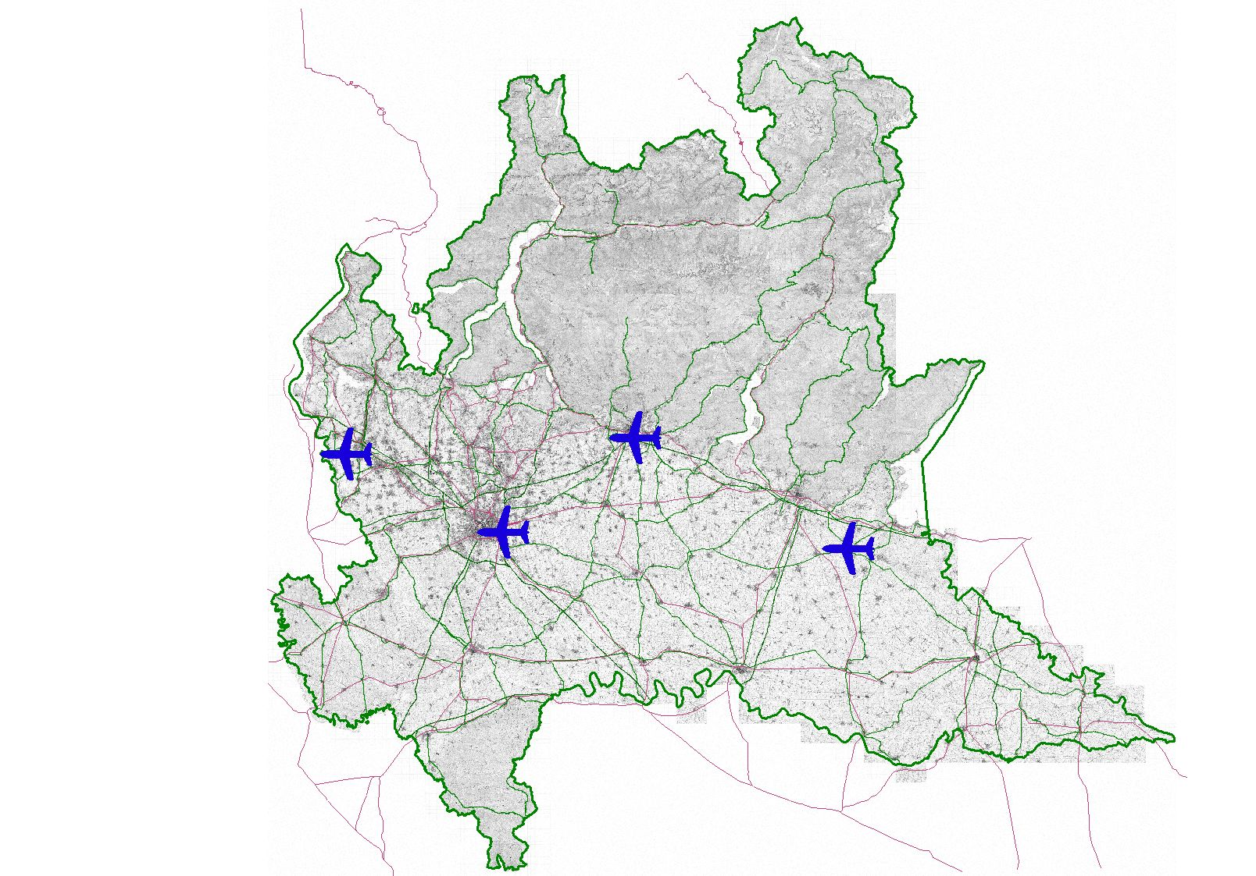
AIRPORT NETWORK
Cooperazione Territoriale Europea

Slide 8
Malpensa PTRA
A land planning instrument
Regional initiative
Area defined by topic
Strong participation
Prescriptive as soon as approved
Objectives:
Better airport connectivity from Northern Italy
Dealing with environmental impacts
Fostering inducted economic growth
Reducing hydrogeological risk in the area (Arno stream)
Cooperazione Territoriale Europea

Slide 9
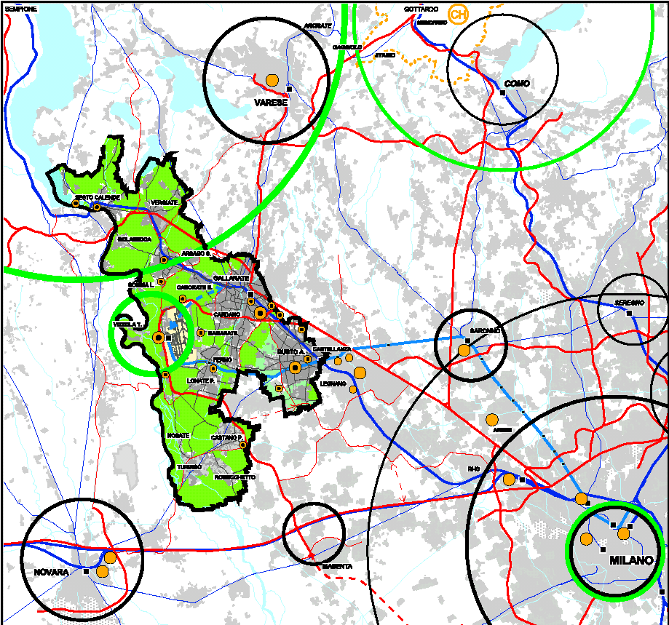
Malpensa PTRA
Cooperazione Territoriale Europea

Slide 10


Sharing the knowledge
Cooperazione Territoriale Europea

Slide 11
hydrogeological risk in Lombardy
Sharing the knowledge
The challenge:
Entrustment of the embodiment of the works of defense of the territorial to local authorities
Regional role of planning, coordination, monitoring and controlling
Plurality of actors, and then need for communication tools and common criteria
Complexity and specificity of the subject, therefore, a need for indications and means of dissemination of skills

Slide 12
the prevention of the hydrogeological risk
Sharing the knowledge
The answer:
Promotion of the quality planning: in cooperation with
professional associations
Work Method: agreement between Lombardy Region, Orders and Associations companies
Find together the actions and priorities
First project: guidelines for the development of the project
A group of professionals and experts interdisciplinary worked together for free

Slide 13
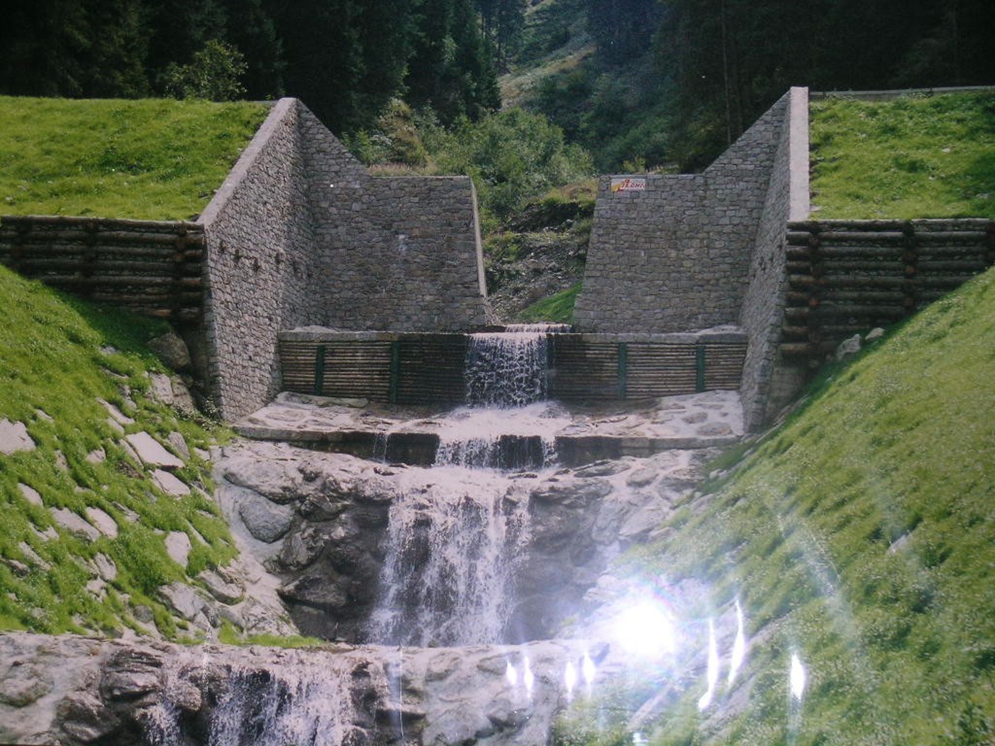
Sharing the knowledge
TERRITORIO E URBANISTICA
THEMES - PROJECT - PECULIARITY
Who can benefit
  PROFESSIONALS
  contents and processed pursued by
  Tender projects
GUIDELINES
  Contents and processed produced
  at the various stages of a project
  PUBLIC ADMINISTRATIONS
  OVERALL OBJECTIVE:
  Increase the effectiveness of interventions for land defense
Cooperazione Territoriale Europea
Notes:
Nel delineare gli aspetti principali delle Linee di Indirizzo 2 elementi assumono particolare rilievo: i destinatari e l’obiettivo.
Che, se vogliamo, si gioca su due elementi, i soggetti cui principalmente ci si rivolge, e l’obiettivo che ci si pone.
Destinatari principali, o finali, sono i soggetti che si occupano della progettazione degli interventi di difesa del suolo, da una parte, e le pubbliche amministrazioni, che agiscono nel sistema-progetto attraverso i bandi. L’obiettivo generale è aumentare l’efficacia degli interventi di difesa del suolo, a salvaguardia dei contesti ambientali e abitativi interessati.
Le presenti linee di indirizzo mirano a raggiungere questo obiettivo attraverso la definizione dei contenuti di massima da inserire nella progettazione delle opere di difesa del suolo, con l’obiettivo di fornire alcune indicazioni ai professionisti ed al contempo garantire che nei bandi di progettazione emanati dalla Pubblica Amministrazione siano introdotti dei parametri volti a ricercare una elevata qualità progettuale.

Slide 14
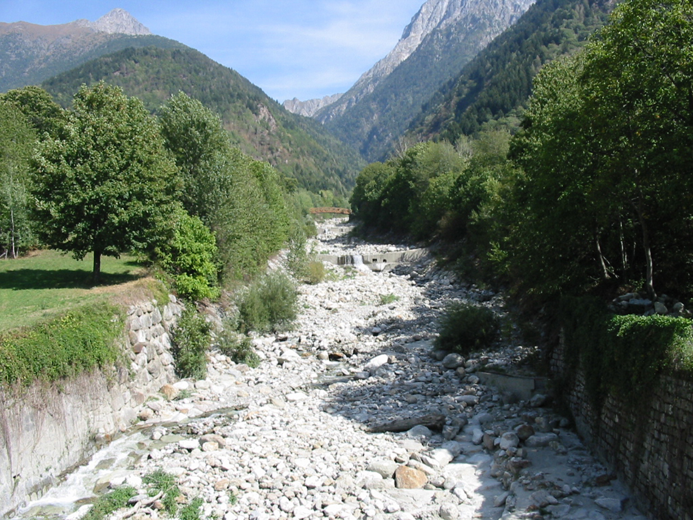
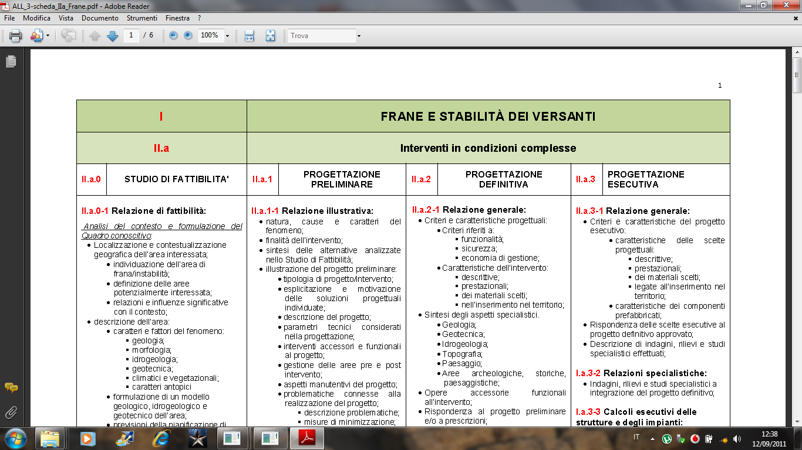
TERRITORIO E URBANISTICA
Summary of contents according to intervention type and project level
Cooperazione Territoriale Europea
Notes:
Le schede rappresentano l’estrema sintesi delle “linee di indirizzo”, riprendono la struttura ad albero sviluppata nella parte descrittiva, che procede attraverso successive focalizzazioni dei contenuti. Si prestano ad essere un memento di delle “linee di indirizzo”.

Slide 15
Sharing the knowledge
TERRITORIO E URBANISTICA
Generale coordinator:
May Adriana
Technical coordinator:
Vergottini Cesare
Technical desk staff:
Albertelli Luca,
Alberti Fausto,
Baggini Amos,
Caleffi Carlo,
Confeggi Stefania,
Crippa Fabiano,
Erba Carlo,
Faccenda Floriano,
Ferro Antonio,
Forni Andrea,
Fumasoni Sergio,
Gatti Giuliana,
Nicoloso Alessandro,
Giarratana Vincenzo
Longhin Maurilio, Manerba Augusto, Marletta Stefano,
Moratti Enrico,
Nogara Alberto, Pezzagno Francesco, Pogliani Marco,
Pozzi Matteo,
Pozzoli Roberto,
Prati Anna,
Ravagnati Carlo,
Re Giovanni,
Reatti Walter,
Scenini Laura,
Songini Giovanni,
Tateo Nicola,
Tognon Giorgio, Valsecchi Angelo, Valsecchi Fabio, Vettovalli Pietro.
Further contributors:
Birbes Angela,
Fontana Francesco,
Guglielmini Gabriele,
Recalcati Piergiorgio.
Technical support:
Beretta Luca,
Bruggi Valerio,
Mazzacuva Maria Rosa,
Orobello Giandomenico,
Sormani Massimo.
Cooperazione Territoriale Europea
Notes:
Concludo con una nota doverosa, che vuole essere un ringraziamento, ai professionisti e ai tecnici della Pubblica Amministrazione, che hanno concesso il loro tempo e le loro energie alla elaborazione ed alla stesura delle “linee di indirizzo”.

Slide 16
Promoting innovation
Smart Specialisation Strategy … The challenge
SWOT analysis
& mapping
Show a system of manufacturing skills and scientific lively, broad, diverse and cross between the different areas of specialization with strong potential but also with strong limitations, especially in terms of fragmentation
The challenge is to help the production system within the areas of specialization to seize and
intercept the new market opportunities
Cooperazione Territoriale Europea

Slide 17
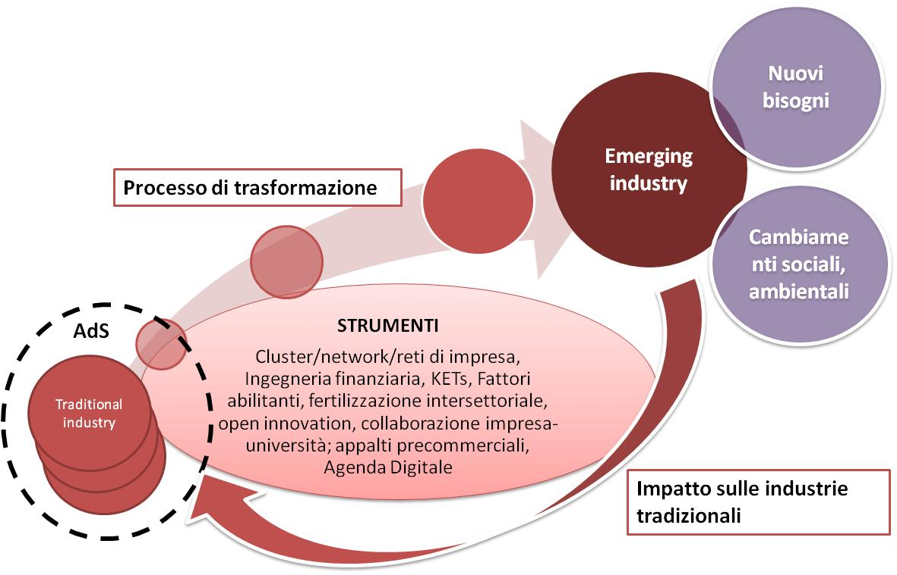
Promoting innovation
Smart Specialisation Strategy …
Enhance the path toward the emerging industries
Cooperazione Territoriale Europea

Slide 18
Promoting innovation
Smart Specialisation Strategy …
The "emerging" industries …
  Characterized by a strong growth
  With a new technology/product to bring to the market
  Generated by the cross sector spillover phenomenon
  that tend to be high knowledge content
  that trigger and allow structural changes in the market
  that reconfigure the value chain to seize new opportunities
Industries
Cooperazione Territoriale Europea

Slide 19
Promoting innovation
Smart Specialisation Strategy …
Areas of specialization: the path of rationalization…
Energy, sustainable constructions and Environment
Tecnologies for Smart communities
Smart Industry
Mobility terrestrial and marine
Creative and Cultural Industries
Science of Life
Tecnologies for environment life
Green Chemistry
Aerospace
Agrifood
Cooperazione Territoriale Europea

Slide 20
Promoting innovation
Some of the tools to promote the emerging industries
emerging industries’ development observatory
Cluster of enterprises
Network/platforms of sharing
Financial Instruments
Human resources development tools
Training system development tools
technological foresight tools
Key Enabling Technologies (KETs)
Digital Agenda
Pre-commercial Procurement and procurement
Open innovation
Fertilisation intersectoral
Collaboration between enterprises and research centres on activities of R&S and innovation
Internationalization tools
…
Cooperazione Territoriale Europea

Slide 21
Thanks for your attention

Slide 22
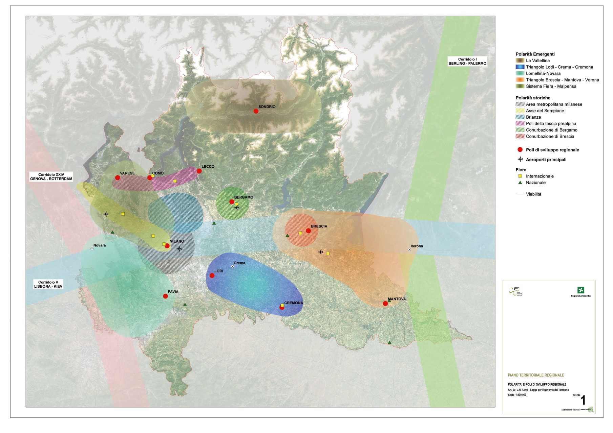
TERRITORIAL SYSTEM
Cooperazione Territoriale Europea

