Slide 1
EATIA (‘ESPON and Territorial Impact Assessment’):
Developing a bottom-up approach for the territorial impact assessment (TIA) of EU policy proposals at the EU member state level
Tom Gore (University of Liverpool)

Slide 2
Structure
Background to the project
Summary of the TIA approach developed
Experiences from testing the approach and next steps

Slide 3
Background
The EATIA project is classified as a ‘targeted analysis’, so has been driven by a specific stakeholder demand. It has been initiated by stakeholders in the UK, Slovenia and Portugal.
Four main criteria for the development of a suitable TIA approach:
Simple, pragmatic and ‘policy-maker friendly’ TIA approach;
Flexible and sensitive to different member state contexts;
Should complement existing member state arrangements/procedures;
Should not lead to new formal assessment obligations, as, for instance, with strategic environmental assessment (SEA) or environmental impact assessment (EIA).

Slide 4
The EATIA project
Five objectives:
To establish the differences and similarities of assessment tools (RIA, SEA, EIA, TIA, rural proofing, etc)
To design a TIA framework
To test the applicability of the TIA framework
To assess the usefulness and benefits of the framework
To draw conclusions and recommendations

Slide 5
The methodological approach
Interactive learning networks
Groups of policy-maker and planning practitioners established in each of the stakeholder countries (UK, PT and SI) (15-20 members).
Consulted throughout the project:
- 3 parallel workshop sessions (January 2011, May 2011, March 2012)
- 2-3 testing workshops (December – January 2012)
- Communicated informally between workshops sessions
A point of contact between the project team and potential end-users of the approach

Slide 6
The TIA framework
The ‘framework’ has been built around three core elements:
Process: The main procedural stages of the framework
Screening
Scoping
Assessment
Evaluation
Methods: The techniques applied in each stage of the process - matrices, checklists, logical chains.
Governance: How the methodological aspects of the framework can be operationalised in practice.
Sub-units

Slide 7
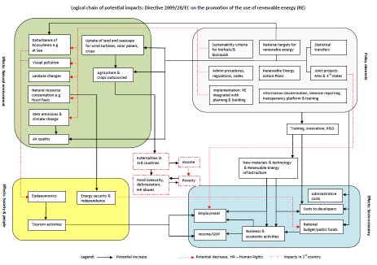
The approach/framework – in brief
Screening:
Aims to determine on a case-by-case basis, whether a TIA should be carried out. It is likely to be particularly desirable if unintended / adverse impacts are considered likely.
2 supporting techniques that could facilitate this process:
Logical chain approach: a form of brainstorming that can be used to identify potential policy impacts
Checklist: ensures that impacts are systematically considered on important territorial characteristics (e.g. employment, economic development, biodiversity, etc) to ensure that no important impacts are overlooked.
Other sources of information, e.g. Outputs Commission’s Impact Assessment procedure.
Logical chain

Slide 8
The approach – a summary/overview
Scoping:
Aims to steer the TIA process (less flexible)
Two main activities:
Leads to the development of an Impact Assessment Matrix (IAM) which structures the Assessment Stage and the identification of specific sub-national localities to conduct the assessment.
Scoping checklist
Policy or policy elements | Criterion | Major impact at the national or local level? Yes (√), no (x), uncertain (?) | Location/ features of areas likely to be affected? | Comments
Policy element A: Emergency planning | Economic development
 | Employment
 | Poverty
 | Cont ....
Preliminary identification of potential impacts, building of any work done in screening
Identification of the characteristics of areas likely subject to these impacts (considering e.g. geographic location, presence of a particular resource or activity)

Slide 9
The approach – a summary
Assessment:
Aims to predict impacts (regional or local level)
Undertaken by completing the Impact Assessment Matrix:
Specifies the types of impacts (e.g. employment, soil pollution, economic growth) that should be considered.
Magnitude (0,1, 2)
Orientation (increase or decrease)
Temporal distribution (short term, medium term, long term)
Impact Assessment Matrix
Criterion | Nature of impact | Policy .......
Employment | Magnitude (0, 1, 2)
 | Orientation against baseline (increase or decrease?)
 | Temporal distribution (Short term, medium term, long term?)
 | Comments and justification
Economic development | Magnitude (0, 1, 2)
 | Orientation against baseline (increase or decrease?)
 | Temporal distribution (Short term, medium term, long term?)
 | Comments and justification
Cont .....
3 Impact characteristics
Ideally, should be completed in a participatory setting in light of available sources of information (outputs of the screening and scoping stages and also locally available information).

Slide 10
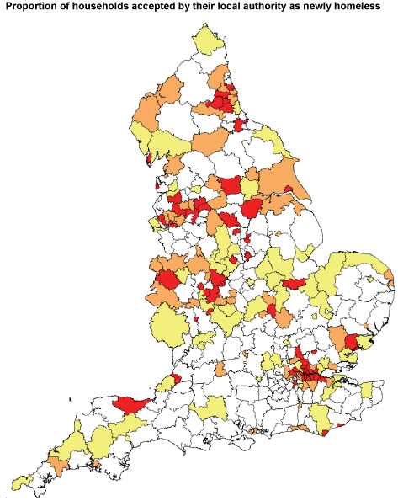
The approach – a summary
Evaluation:
The evaluation helps member states determine whether actions need to be taken to mitigate or promote impacts.
Impact Evaluation Table
Policy objectives | Impact significance? (-2, -1, 0, +1, +2) | Justification
OBJECTIVE 1
OBJECTIVE .....
Aims to determine what the impacts mean for a member state
2 activities:
Amalgamation and synthesis of the outputs of the sub-national assessment stage (e.g. charts, thematic mapping)
Evaluation of the identified impacts, in terms of member state policy objectives/aspirations framed in policy documents. Undertaken using an Evaluation Table, which structures this process.

Slide 11
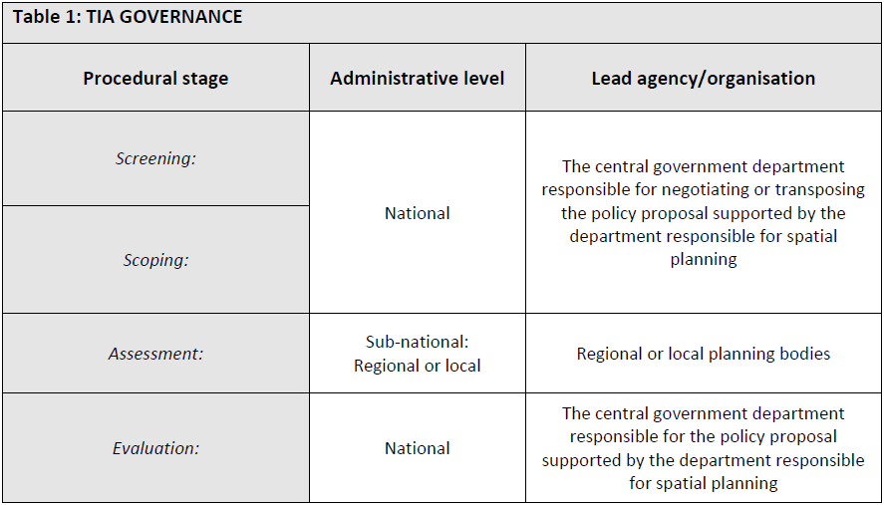
Generic TIA governance arrangements

Slide 12
Reflections/Experiences
So far our experiences suggest that:
A TIA could theoretically take as little as 2-3 days to complete, provided that the right resources are available.
Practitioners generally find the approach straightforward to apply. Although there would be some training requirements if the approach is to be implemented.
Different potentials exist in different member states to implement the approach in a ‘pain-free’ way. Member states that already carry out RIAs of EU measures may find it easier to implement than those that don't.
One of the biggest barriers to the approach could be the reluctance of sub-national authorities to actually participate in the process (e.g. limited resources) - they may not see TIA as a priority.

Slide 13
Next steps?
Further testing of the approach (outside of the scope of the project):
Other member states
Real-time policy development process (so far only applied to adopted policies).
A web-based platform to operationalise the approach?
Electronic matrices / checklists, alert mechanisms, etc
Facilitate the management of the procedure

Slide 14
Thank You

