Slide 1
Transformation of regional indicators
with functional neighborhood
Claude GRASLAND
ESPON M4 Project

Slide 2
Plan
1. METHODOLOGY
1.1) The limits of regional data (MAUP & MTUP)
1.2) The definition of functional neighborhood
1.3) Creation of new indicators
2. APPLICATIONS
2.1) Functional typology of cross-border regions
2.2) Functional definition of growing regions
2.3) Functional analysis of local convergence

Slide 3
METHODOLOGY

Slide 4
The modifiable temporal unit probleùm
Evolution year by year
Moving average 6-years
CHANGING PERCEPTION OF REGIONALTRENDS
ACCORDING TO TIME AGGREGATION
(Modifiable Temporal Unit Problem)

Slide 5
The modifiable areal unit problem
90
110
130
CHANGING PERCEPTION OF REGIONAL LEVELS
ACCORDINGTO SPATIAL AGGREGATION
(Modifiable Areal unit Problem)

Slide 6

Functional neighbourhood (1)

Slide 7
Functional neighbourhood (2)
SEA
Highway
Highway

Slide 8
Functional neighbourhood (3)
SEA
Highway
BORDER
BORDER
Highway

Slide 9

Defintion of functional potential
$$POTENTIAL \left(i\right)=\sum_{j=1}^{n}{SIZEj ×f\left(TIMEij\right)×g(BORDERij)}$$
1 000
1 000
400
600
1 000
1 000
20
50

Slide 10
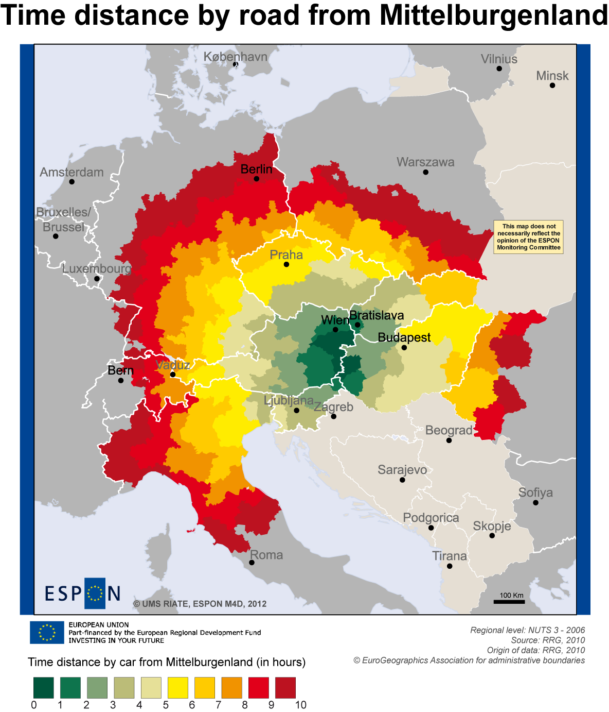
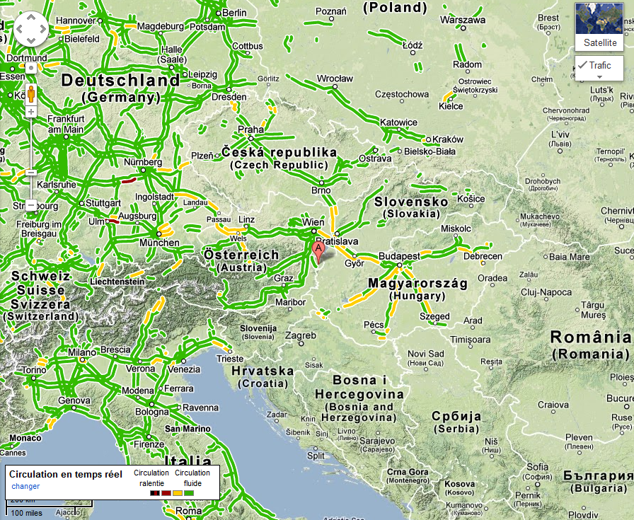
Application to road distance

Slide 11
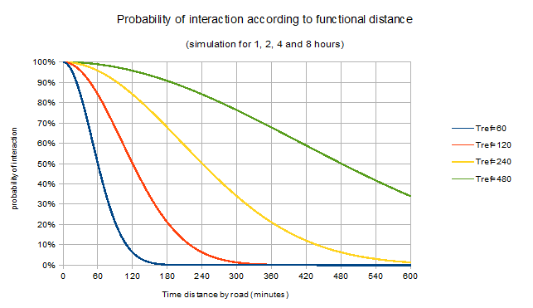
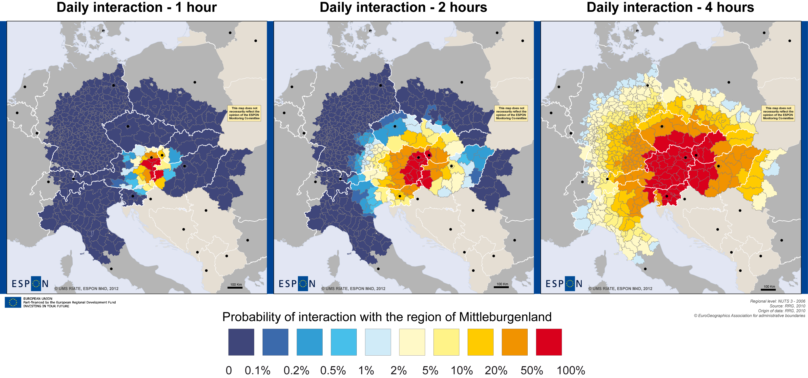
Choice of interaction parameters

Slide 12
APPLICATIONS

Slide 13
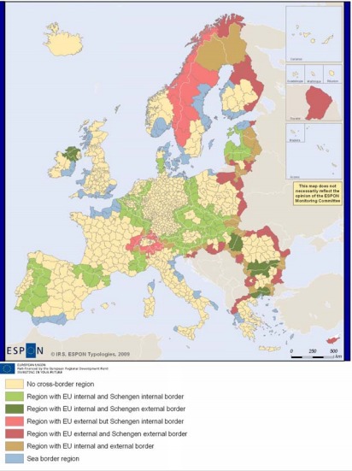
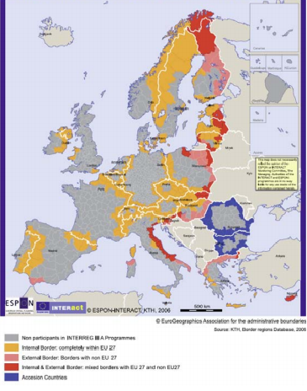
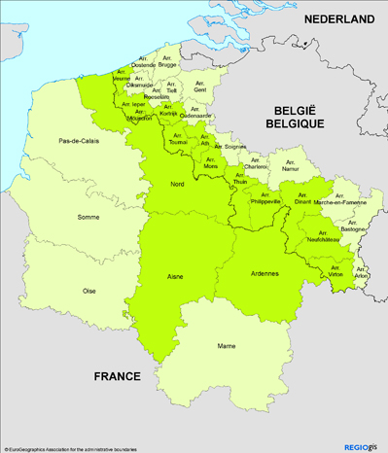
A functional typology of border regions(1/3)
A typical example
of Modifiable Area
Unit Problem
ESPON INTERACT
ESPON TYPOLOGY

Slide 14
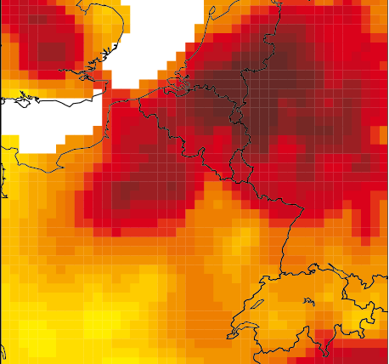
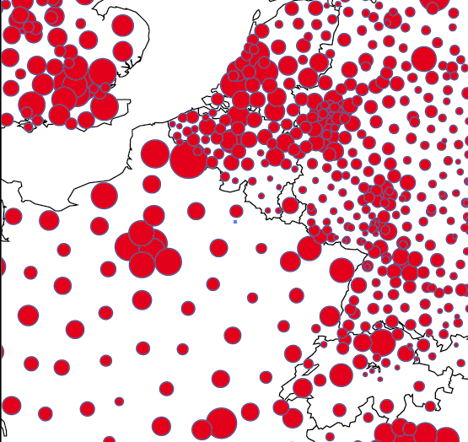
A functional typology of border regions (2/3)
Potential (open)
Population 2008
Share of international
Potential (closed)

Slide 15
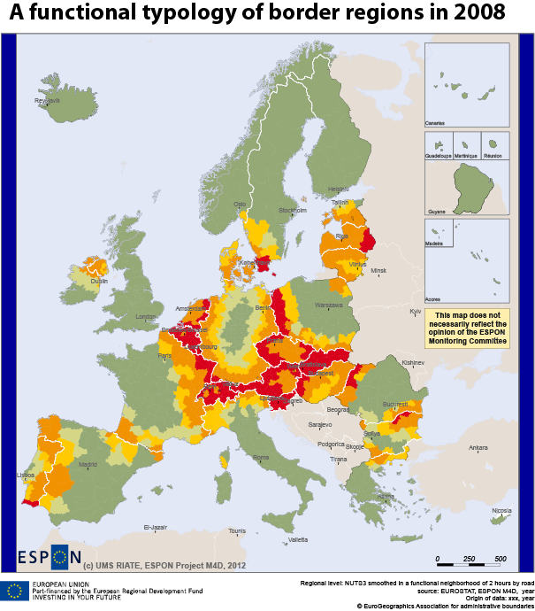

A functional typology of border regions(3/3)
Definition of border regions by the share of international relation in functional potential of population based on 2h road distance
Different levels of international dependency according to the hypothesis made on functional relations
Assymmetry of borders effect (ex. between Germany and Poland) related to differences of density or accessibility.
Share of potential of population located in foreign countries for a functionnal neighbourhood of 2 hours by road

Slide 16
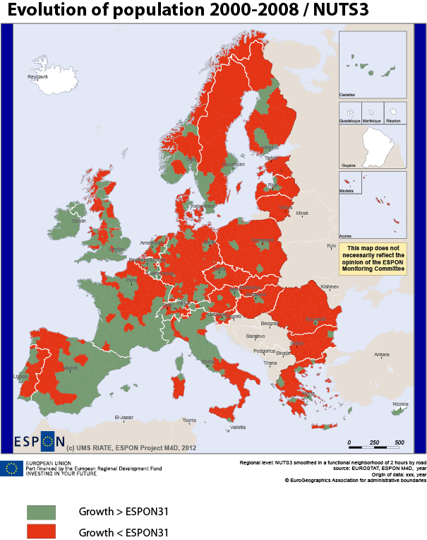
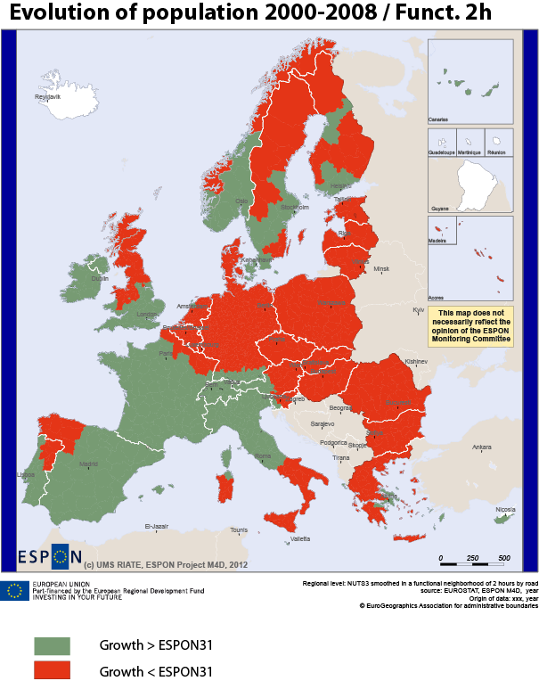
A functional view of growing regions(1/4)

Slide 17
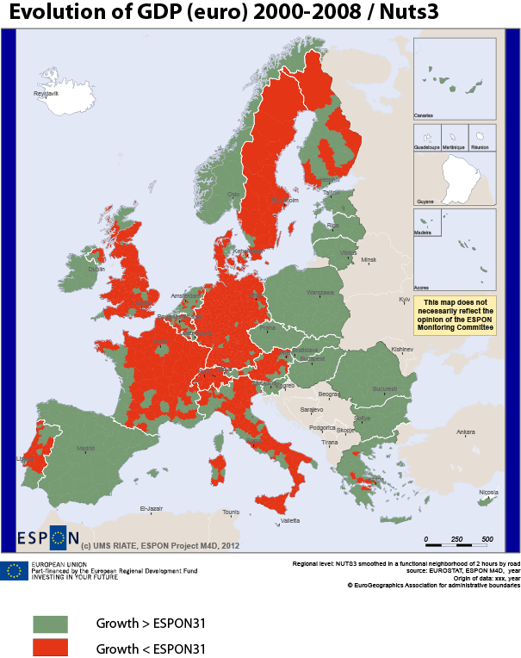
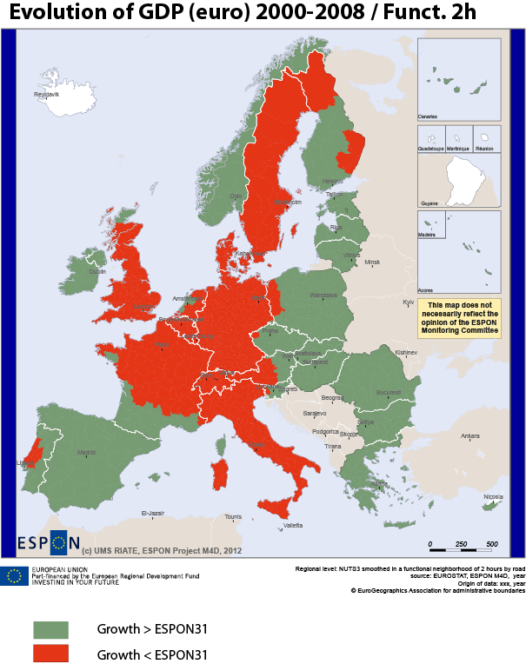
A functional view of growing regions(2/4)

Slide 18
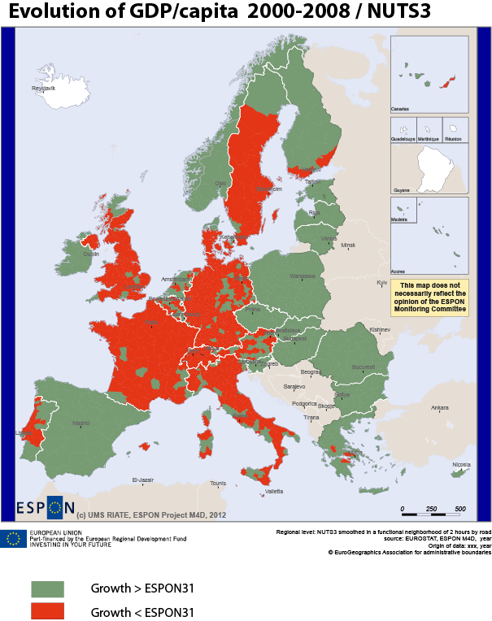
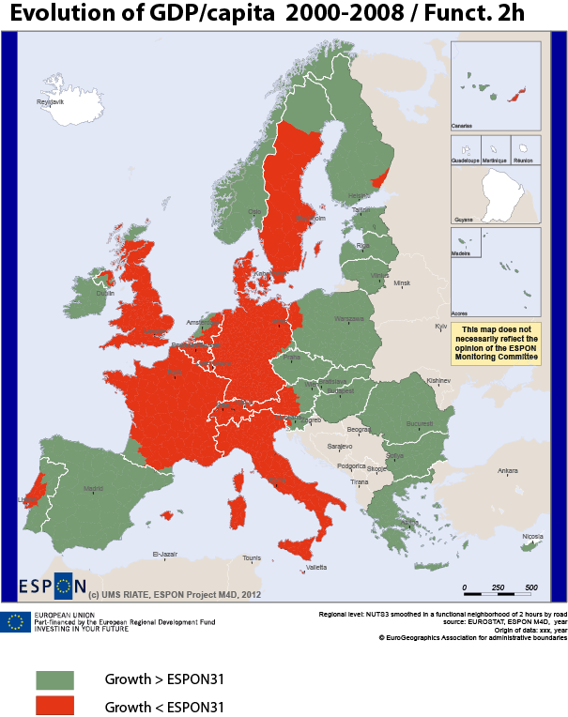
A functional view of growing regions(3/4)

Slide 19
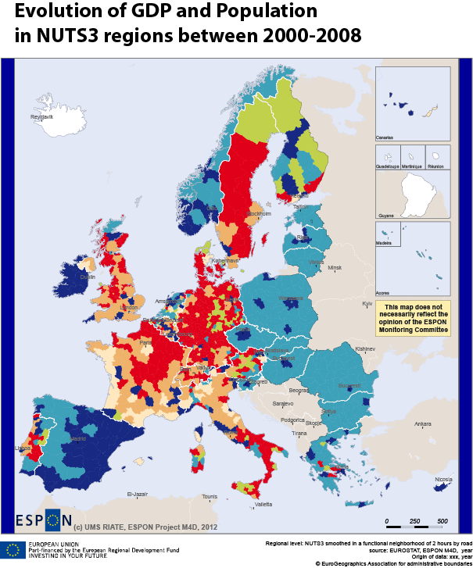
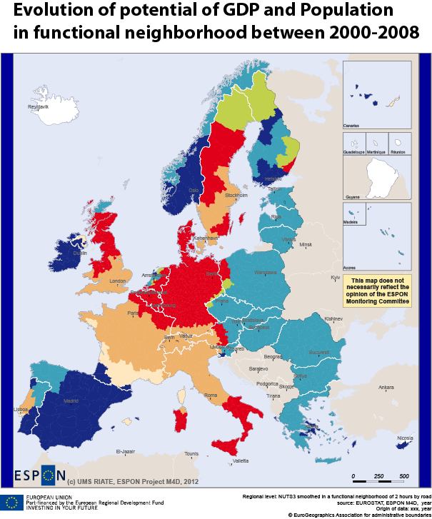
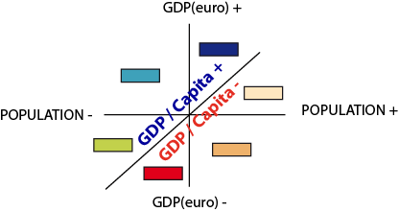
A functional view of growing regions(4/4)

Slide 20

Local convergence of EU regions (1/5)
“ More recent contributions also introduce a spatial dimension into the formulation of the problem (see for instance Baumont et al., 2003 or Dall’erba and Le Gallo, 2006). There are indeed reasons to believe that the omission of a space from the analysis of the regional Beta-convergence process is likely to produce biased results”.
Philippe Montfort, 2008

Slide 21
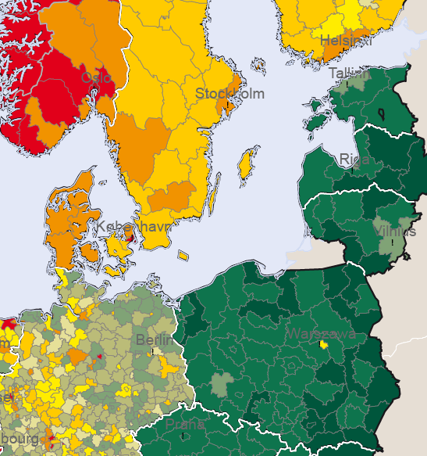
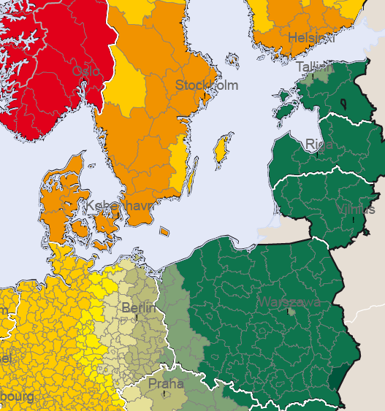

Local convergence of EU regions (2/5)
Local functionnal average (2 h)

Slide 22
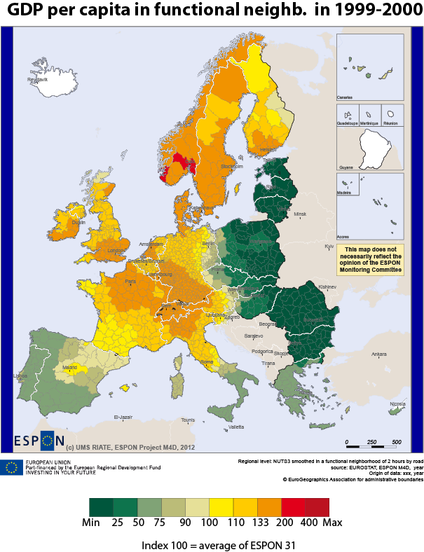
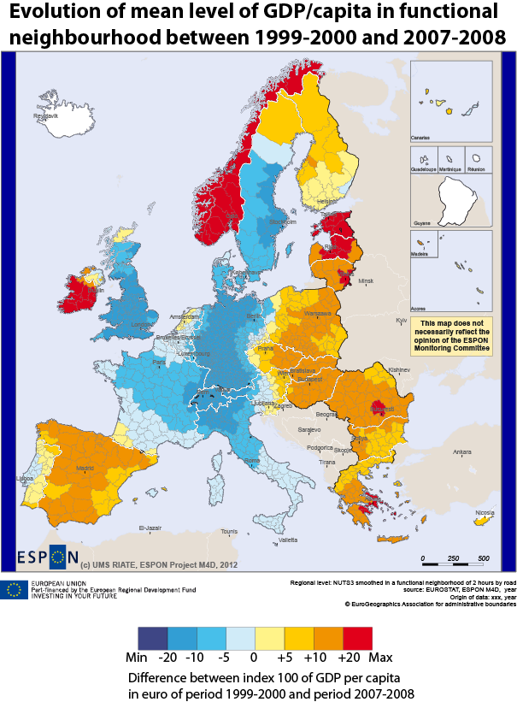
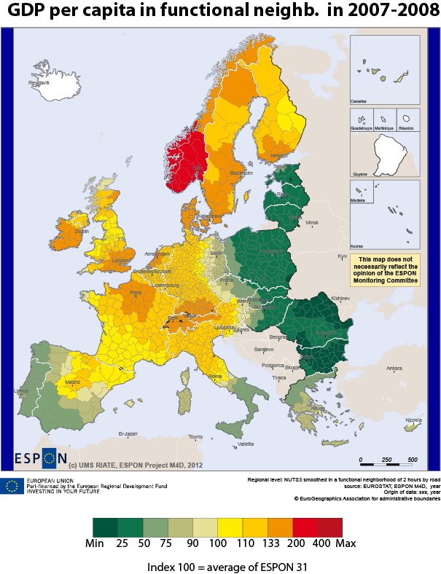
Local convergence of EU regions (3/5)

Slide 23
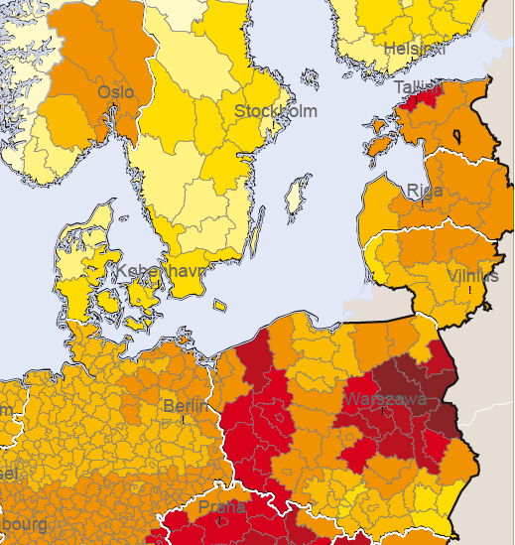
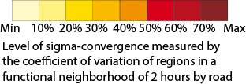
Local convergence of EU regions (4/5)
Local sigma heterogeneity (2 h)

Slide 24
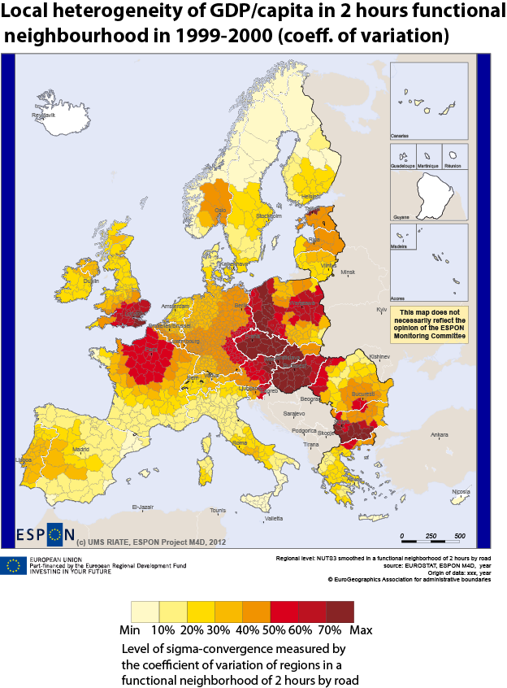
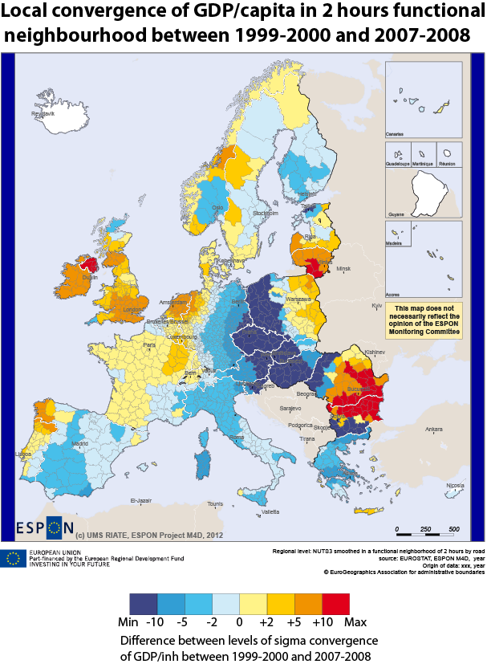
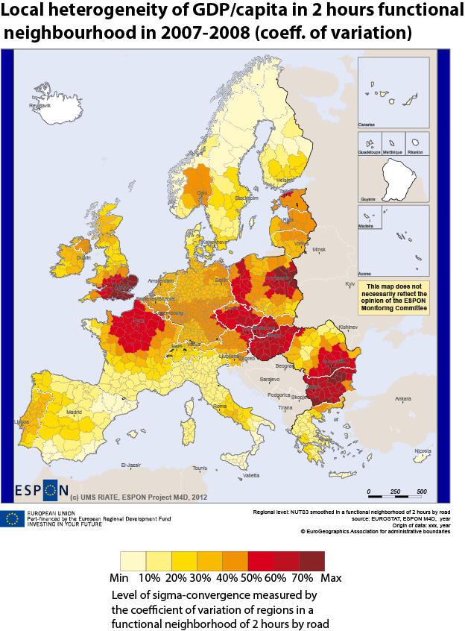
Local convergence of EU regions (5/5)

Slide 25
CONCLUSION
How to create an innovative and sustainable database for the monitoring of territorial cohesion ?

Slide 26

The core database strategy of M4D
Focus on the storage of count variables
Store formula of indicators of interest derived from count variables
Enlarge time series of count variables in past and future with estimation of missing values
Develop procedure of exchange of count variables between geometries of various types
Propose innovative procedures of multi-level analysis of indicators for territorial monitoring

