Slide 1
ESPON EU-LUPA
ESPON 2013 Programme Internal Seminar
Evidence-based Cohesion Policy: Territorial Dimensions
Kraków, Poland
30.11.2011

Slide 2
Project aim
This project is about combining and aggregating land cover, land use and administrative data into meaningful typologies as potential input for policy making at European, national and regional level.

Slide 3
Main questions
What are the main characteristics of ongoing changes in land use and land use patterns?
To what extent and how are changes in land use patterns interacting with ongoing socio-economic developments?
How can typologies reflect on both levels of change, i.e. the physical characteristics of land use patterns, and the dynamics behind these changes?
Are the trends sustainable (performance and efficiency), and to what extent will the ongoing changes compromise future developments?

Slide 4
Project Partners

Slide 5
Land ucover typology
What is required from a European land cover typology that shall be used to understand land cover as an indicator in relation to the processes of Sustainable Development?
1. A typology enabling the identification of major land cover characteristics determined by distinct development backgrounds
2. A typology enabling the identification of land cover change dynamics determined by distinct development processes
3. A typology relating to the overall concepts of intensification and extensification as key measures of human interaction with the environment
4. A typology where the identified categories are connecting to the overall drivers of economy and population in the development process

Slide 6
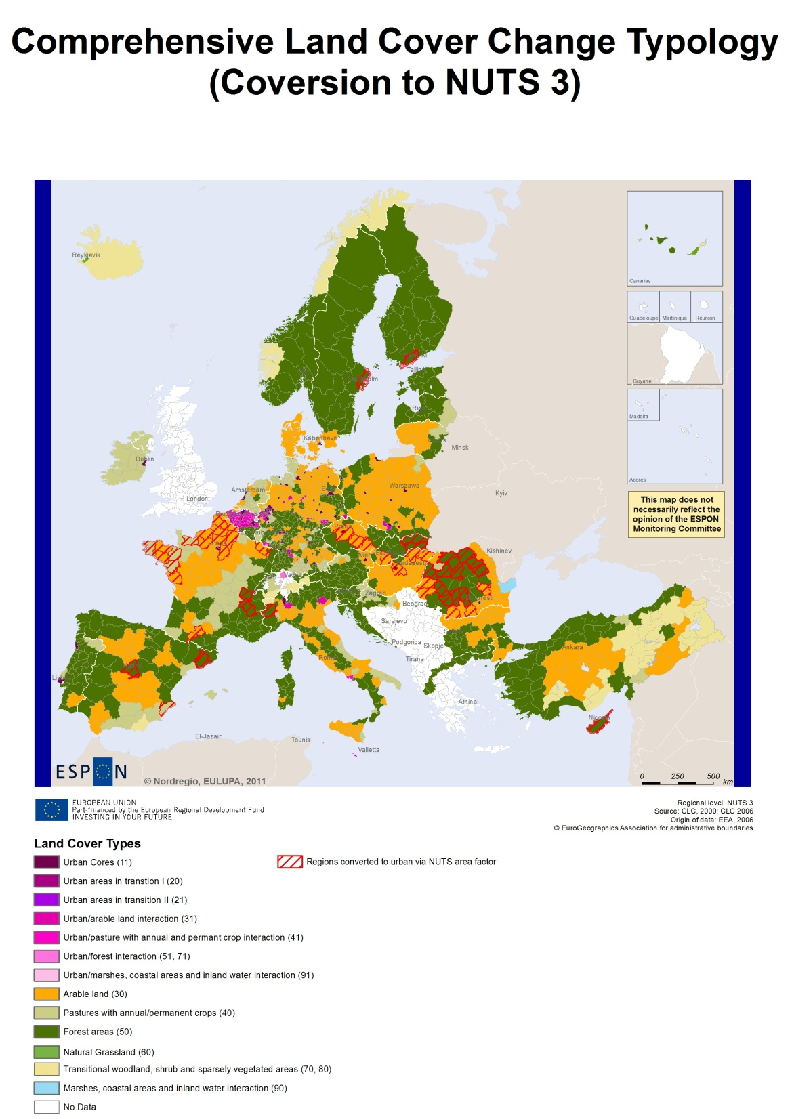
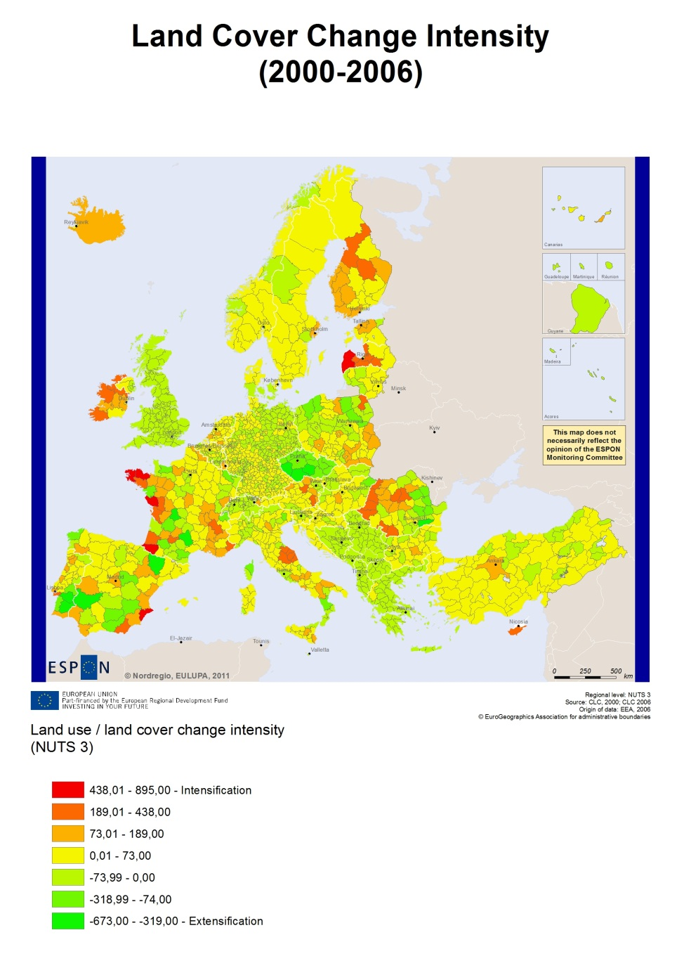
Constant characteristics of land cover
Map 26: Land Cover Change Intensity - 2000-2006
Notes:
2000-2006 mainly man induced changes.
A keyword of human induced land cover change is intensity. In this perspective intensity relates to the productive (and reproductive) capacity to of the land in relation to society. Figure 7 show how there are clear indications that the land cover patterns are characterized by changes towards increased intensity through urbanization trends, as well as intensive agriculture and forest cover. These are taking place at the expense of land cover characterized by extensive agriculture and bare, semi-natural landscapes. Put this way, land cover change is inseparable from the question of human activities.
Impact of CAP: German-Danish border. Preservation of forest and arable land in Poland.

Slide 7
Land Use Functions
Changes based on CLC are too narrow to understand land use dynamics in EU27
To assess the impacts of land use change in a comprehensive way: multi-criteria analysis
The Land Use Functions provide a way to enhance the understanding of:
  Multi-functionality
  Sustainability: integration of the economic, social and environmental dimension
  Performance of regions according to their Land Use Functions (patterns) and their changes in time (trends)

Slide 8
The LUFs method: aggregation scheme
Sustainability
0.333
0.333
0.333
Society
Economy
Environment
0.166
0.166
0.166
0.166
0.166
0.166
LUF1: Work
LUF2: Leisure & recreation
LUF3: Food & energy
LUF4:Housing Infrastructure
LUF5: Abiotic resources
LUF6: Biotic resources
7
8
2
7
1
4
5
7
1
3
3
12
12
15
9
11
6
21
13
18
5
12
16
17
17
18
12
15
24
27
21
26
16
17
19
20
19
21
25
19
20
21
25
1
Indicator
21
Basic aggregation scheme, after Paracchini et al. (2008). The symbols represent individual indicators contributing to more than one LUF

Slide 9
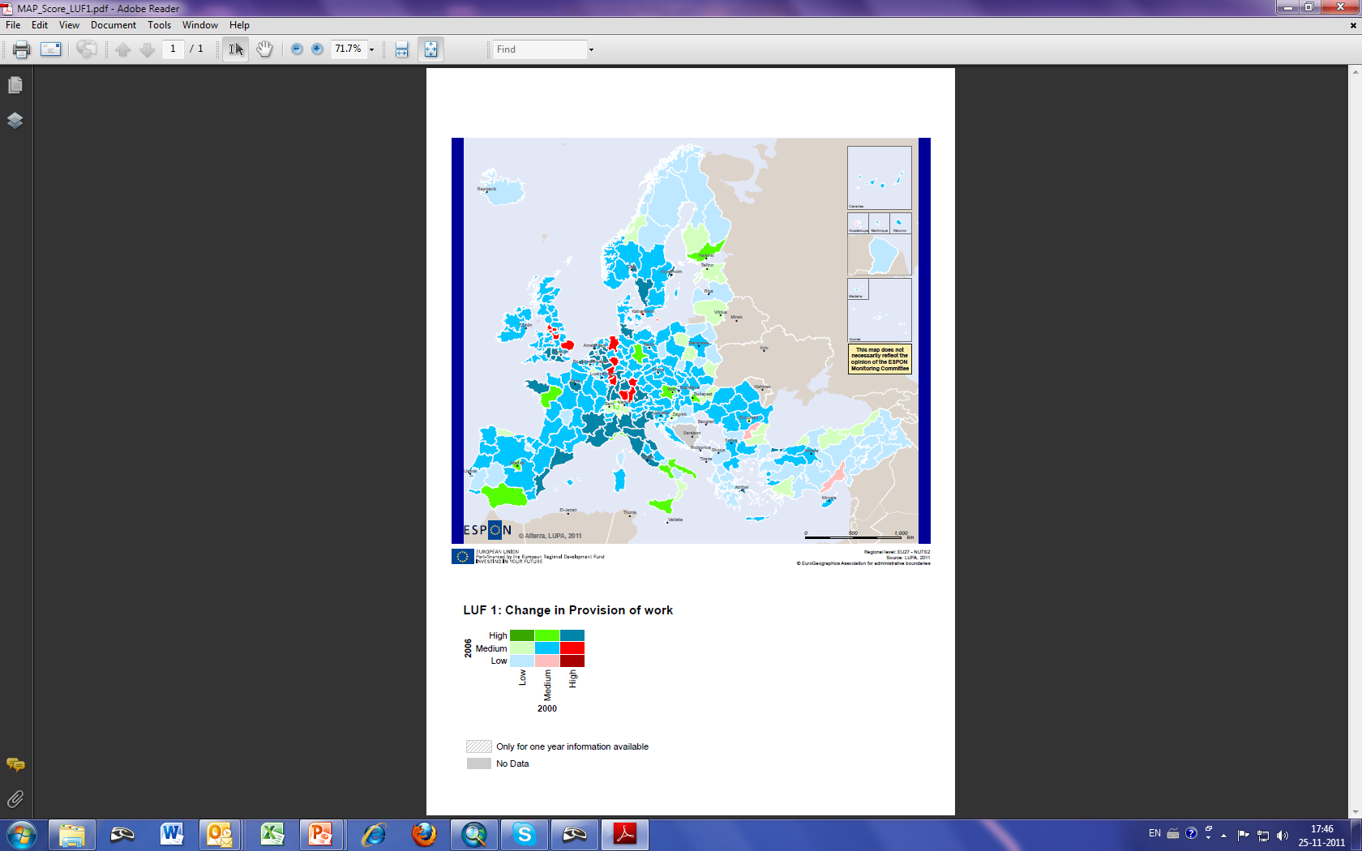
LUF1 – Provision of work

Slide 10
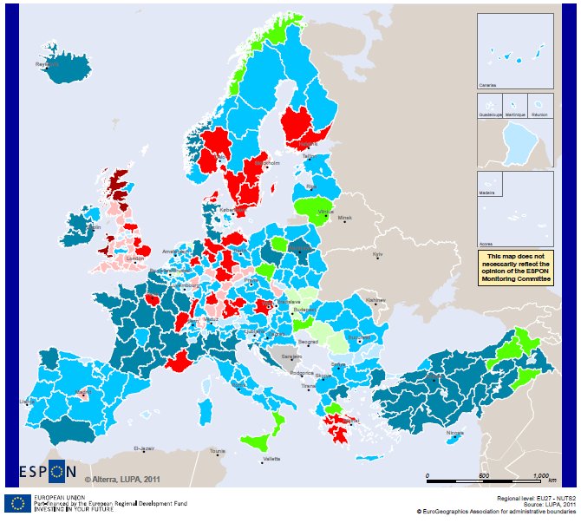
LUF3 – Provision of food and bioenergy
3

Slide 11
Policy implications
The project is covering the period 1990-2006, previous to the crisis: understanding of the starting conditions of regions.
Understanding the drivers behind the process is key to evaluate performance and efficiency.
Analysis of multifuncionality can provide an insight on regional potentialities and policy alternatives.
The proposed methodology can be applied at different scales. Also a useful tool for regions where they have better and more detailed data (case studies).

