Slide 1
European Seas and Territorial Development
Opportunities and Risks (ESaTDOR)
Dave Shaw and Lynne McGowan
Liverpool University, UK

Slide 2
STEPPING INTO THE WATER
ESPON (DG Regio): promoting territorial cohesion through research into spatial patterns and potentialities across Europe
Traditionally focused on land as the locus of spatiality: the sea perceived as a hindrance to cohesion?
Growing awareness of territorial dimensions of European seas, following EU maritime policy
Taking the territorial beyond the terrestrial
Hence first ESPON project to consider marine space as integral to European territory: ESaTDOR

Slide 3
EU TERRITORIAL AGENDA 2020
Europe 2020 emphasises need for social, economic and territorial cohesion:
“Maritime activities are essential for territorial cohesion in Europe… The Marine Strategy Framework Directive and EU Integrated Maritime Policy call for coordinated actions from Member States on Maritime Spatial Planning. Such planning should be integrated into the existing planning systems to enable harmonious and sustainable development of a land-sea continuum.”
(Informal Ministerial Meeting of Ministers responsible for
Spatial Planning and Territorial Development, 2011, para55)

Slide 4
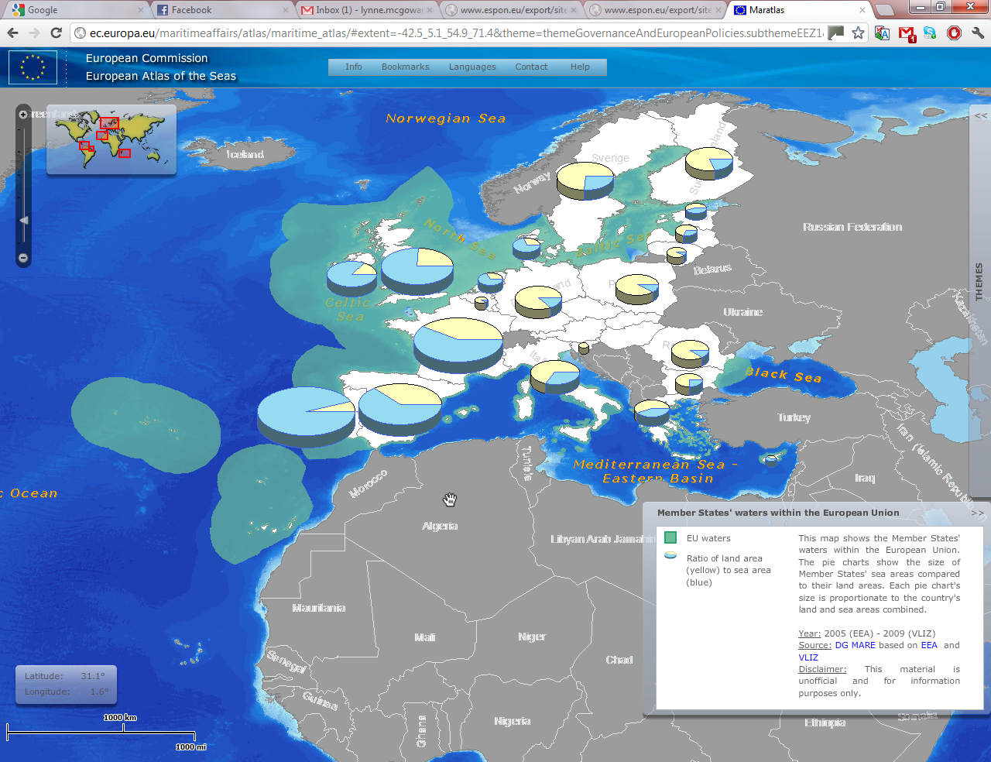
TERRESTRIAL / MARINE TERRITORIES

Slide 5
ESaTDOR in the Context of the CSF
Investment in TEN-Ts – identifying key routes which should be included in TENs and Motorways of the Sea
Removal of bottlenecks in inland waterways- land sea interface
Encouraging resource-efficient modes of transport – innovation in shipping technology, potential for modal switch from road to sea
Identifying vulnerable infrastructure with regard to natural and man-made risks and climate change

Slide 6
ESaTDOR in the Context of the CSF
Developing ports as efficient entry and exit points improving access and hinterland connections
Developing inland waterways for freight networks
More efficient logistics chains (including for fisheries and other maritime industries)
Development of marine energy

Slide 7
DG MARE’S “BLUE GROWTH” INITIATIVE
The ‘Blue Growth’ initiative aims to elaborate the maritime dimension of the Europe 2020 strategy.
"smart, sustainable and inclusive economic and employment growth from the oceans, seas and coasts".
A long term strategy to support growth in the maritime sector as a whole
All the sectoral and cross-sectoral economic activities related to the oceans, seas and coasts
Focus on emerging, existing and potential activities such as short sea shipping, coastal tourism, offshore wind energy, desalination, marine biotech .

Slide 8
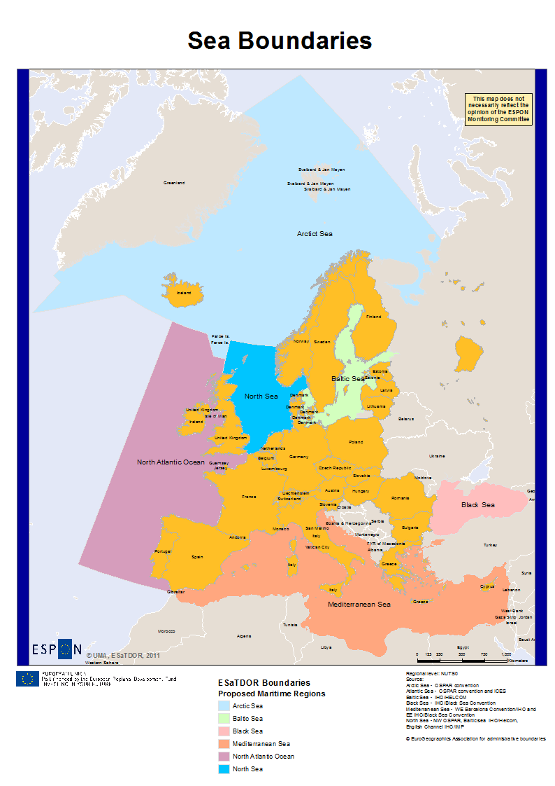
CHALLENGES TO DATA COLLECTION
Lack of availability and consistency of marine data
Inconsistency in maritime boundaries
Varying scale of land sea interactions
Difficulty in disaggregating data sets between land and sea and between sea areas
Lack of established protocol for sub-sea mapping

Slide 9
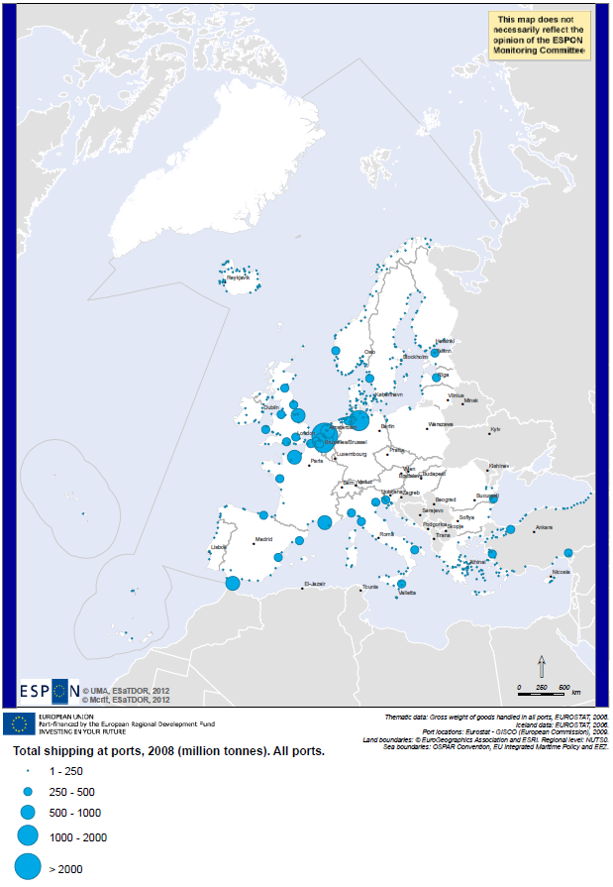
MAPPING AVAILABLE DATA
Shipping lanes
Main ports

Slide 10
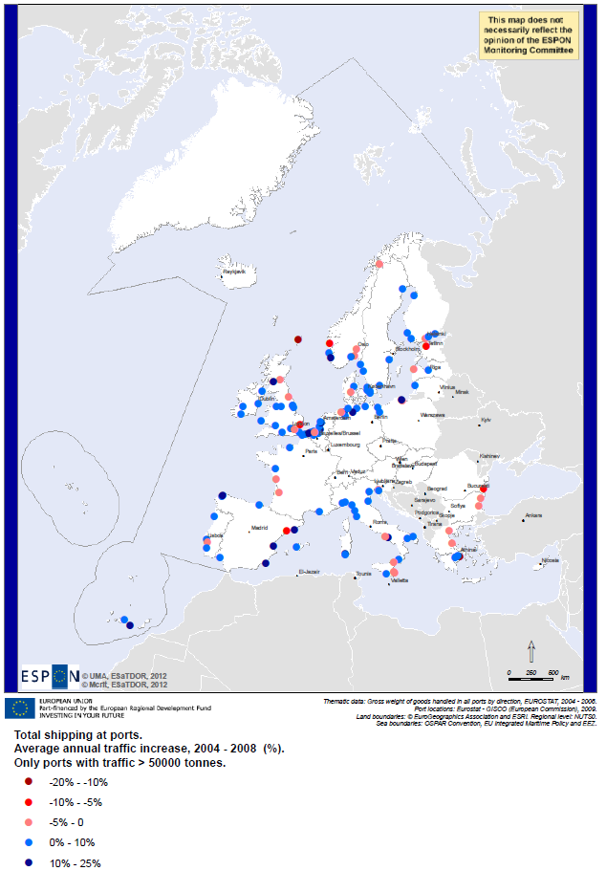
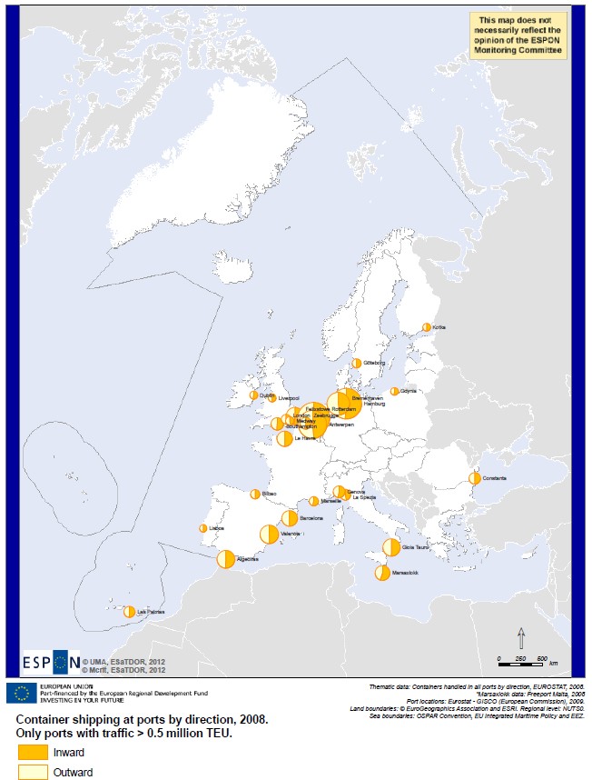
MAPPING AVAILABLE DATA
Change in goods transport 2004-08
Container traffic: imports and exports

Slide 11
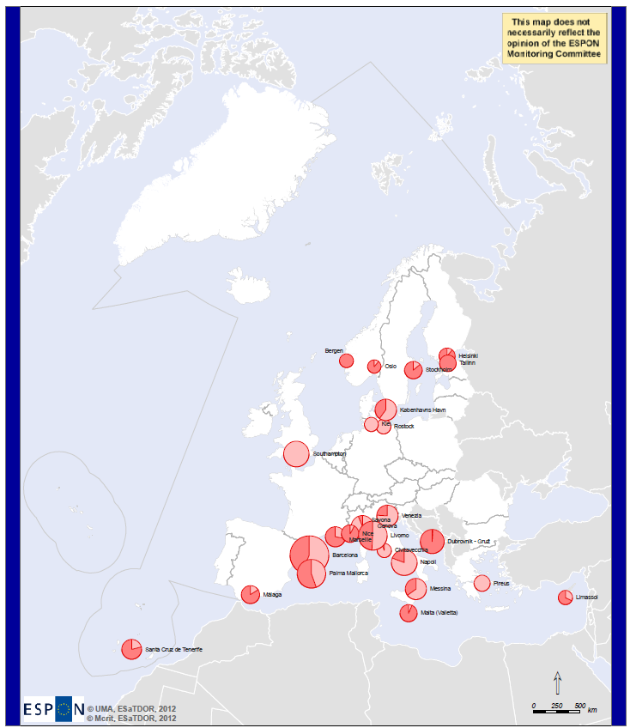
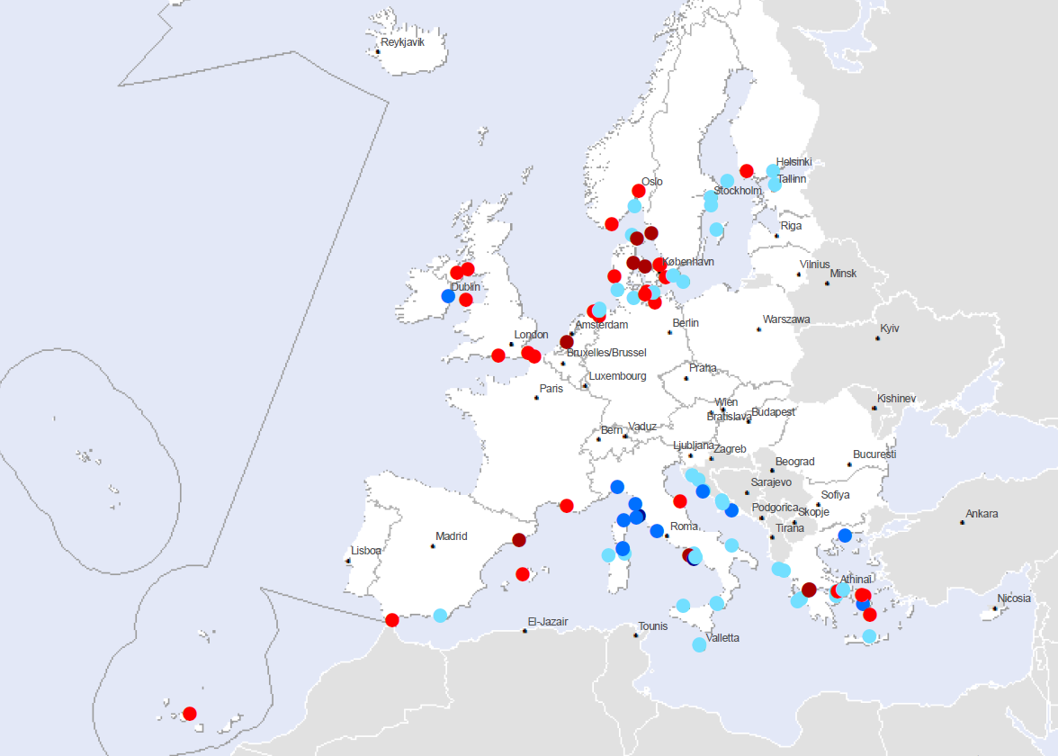
MAPPING AVAILABLE DATA
Cruise ports: start/end points and excursions
Change in ferry passenger numbers, 2004-08

Slide 12
MAPPING AVAILABLE DATA
Existing Wind Energy Capacity
Wave Power Potential

Slide 13
MAPPING AVAILABLE DATA
Employment (fisheries)
Employment (shipbuilding)

Slide 14
MAPPING AVAILABLE DATA
Invasive Species
Increase in Sea Surface Temperature

Slide 15
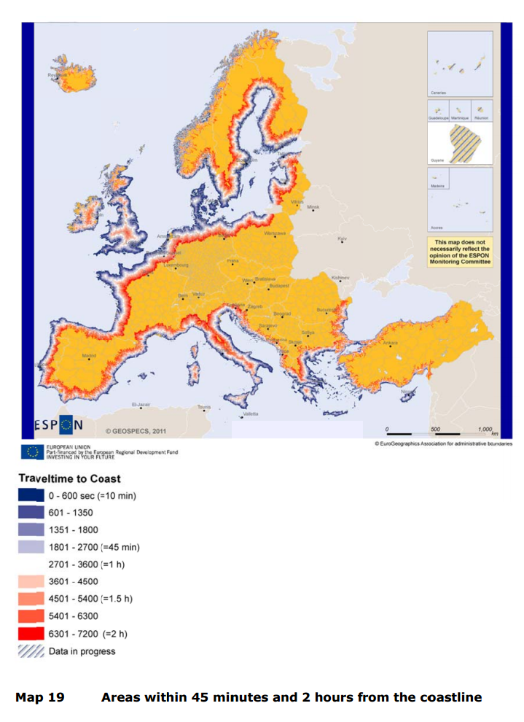
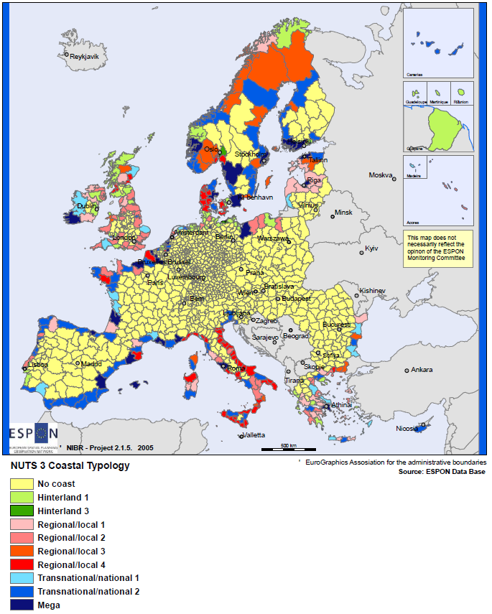
TOWARDS A MARITIME TYPOLOGY
ESPON – Territorial Impacts of European Fisheries Policy (Project 2.1.5)
ESPON GEOSPECS

Slide 16
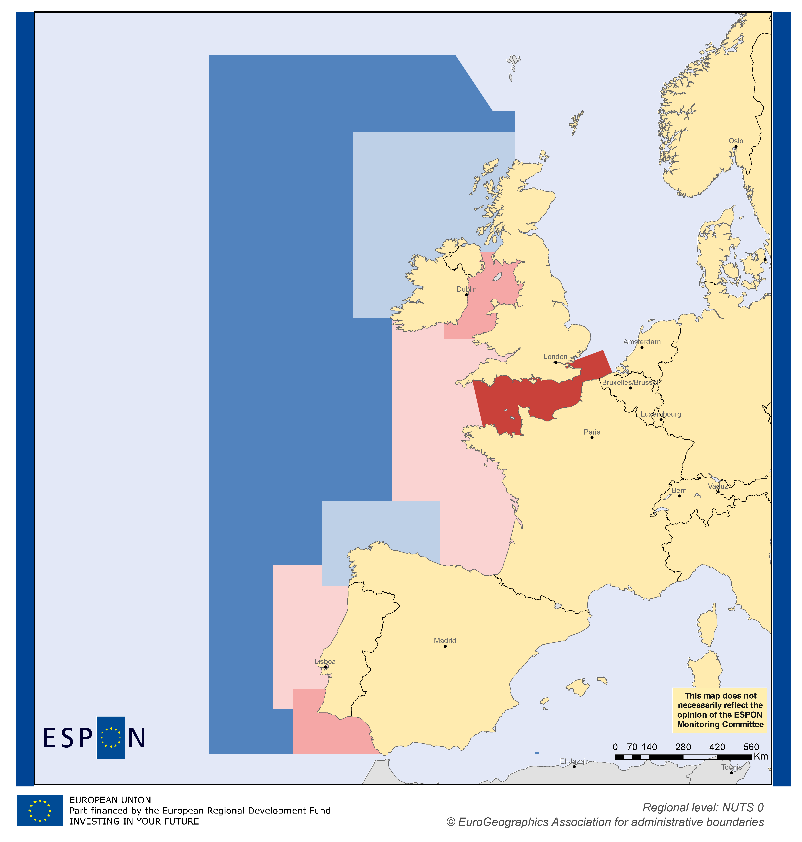
A RUDIMENTARY MARITIME TYPOLOGY

Slide 17
TOWARDS A MORE SYSTEMATIC TYPOLOGY
Three sets of indicators, representing wide range of maritime sectors and interests:
1. Employment (land-based)
2. Connectivity and flows (land-sea interaction)
3. Environmental pressures (sea-based)

Slide 18
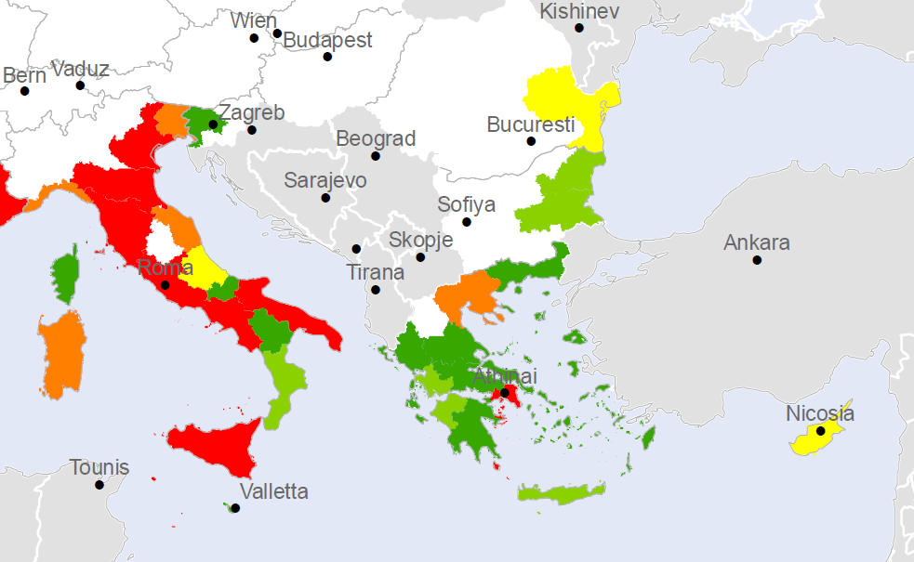
COMPOSITE MAP 1: ECONOMIC SIGNIFICANCE

Slide 19
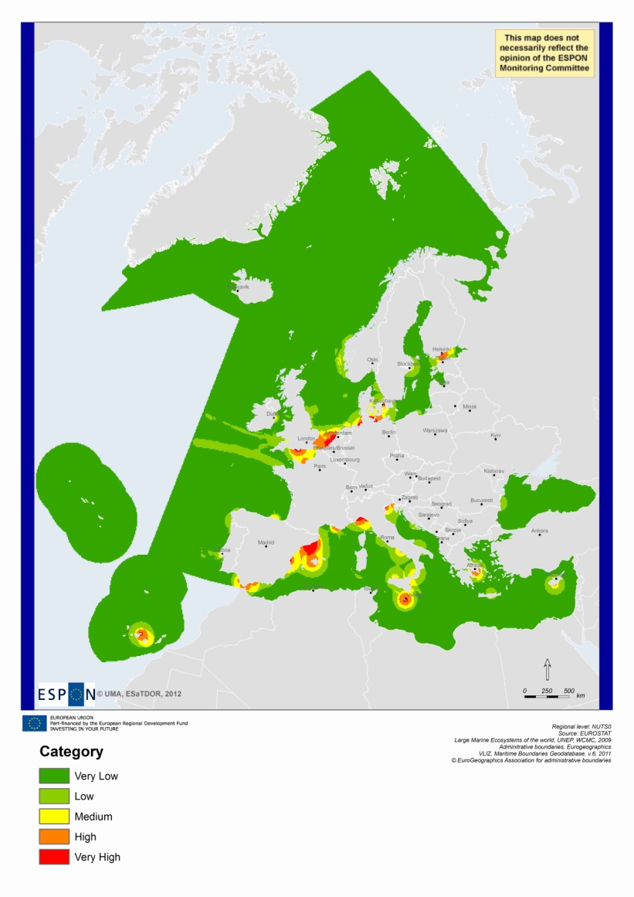
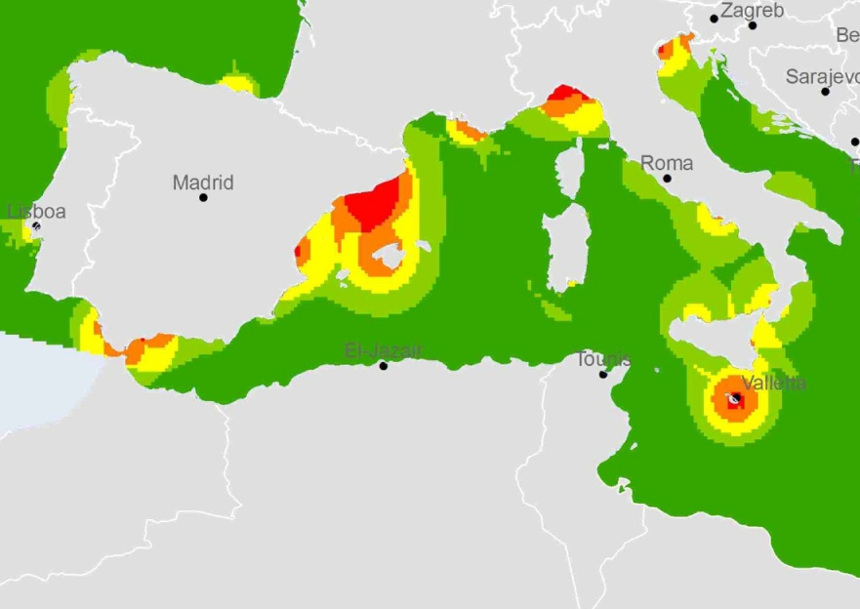
COMPOSITE MAP 2: FLOWS

Slide 20
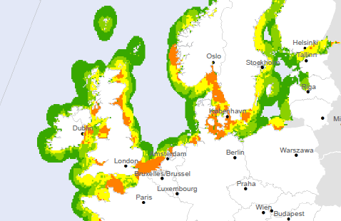
COMPOSITE MAP 3: ENVIRONMENTAL PRESSURES

Slide 21
MARITIME SCENARIO BUILDING
To create spatially explicit policy scenarios for the sustainable development of European maritime/coastal regions
Identification of future scenarios for the sustainable development of different maritime/coastal regions
Based on thematic development trajectories and how they present new opportunities
Will identify opportunities for new forms of integrated planning and development between inland and coastal regions of Europe and with wider non EU areas.
To be undertaken through EU-level expert / stakeholder workshop

Slide 22
EXTENDING SCENARIOS TO THE SEA
Building on associated ESPON project (Territorial Scenarios and Visions for Europe 2050)
Scenario | Terrestrial Focus | Maritime Application?
Europe of FLOWS | Enhanced connections, based on movement of people, goods, information; transport and energy corridors | Intensification of maritime traffic and opening of new routes; growth of cable and pipeline networks and offshore grids
Europe of CITIES | National and regional capitals as drivers of economic growth; preservation of open space | Maximisation of major resource use; increasing attractiveness of coastal cities and surrounding natural and cultural heritage
Europe of BALANCED REGIONS | Specific regional strengths; reduction of social and economic disparities | Marine resource exploitation differentiated according to regional / local potentials
Europe of SELF-SUFFICIENT TOWNS | Environmental sustainability; adapting to low carbon futures, emphasis on endogenous resources | Small scale developments to meet local resource needs; improving environmental standards

Slide 23
Estador’s Relevance to CSF
ESaTDOR’S RELEVANCE TO THE CSF
Anticipated Policy Recommendations and Outcomes:
Consistency and effectiveness of coastal and maritime data collection – enabling spatially targeted funding.
Mapping areas of environmental and economic pressures and resilience to facilitate sustainable blue growth
Innovative ways of understanding land sea interactions and identifying different levels of accessibility in coastal/maritime regions in order to strengthen or develop new transport networks.
Suggestions and encouragement for more effective governance arrangements, including cross-border cooperation at sea basin and sub-sea levels

