Slide 1
Urban delineations and data bases in Europe, ESPON Data Base M4D
A.Bretagnolle¹, M.Guérois¹, H. Mathian¹, A.Pavard¹
¹UMR Géographie-cités, Universités Paris 1 et Paris 7
Aalborg, ESPON Open Seminar 13 June 2012, Development of urban regions in Europe:
Key drivers and perspectives

Slide 2
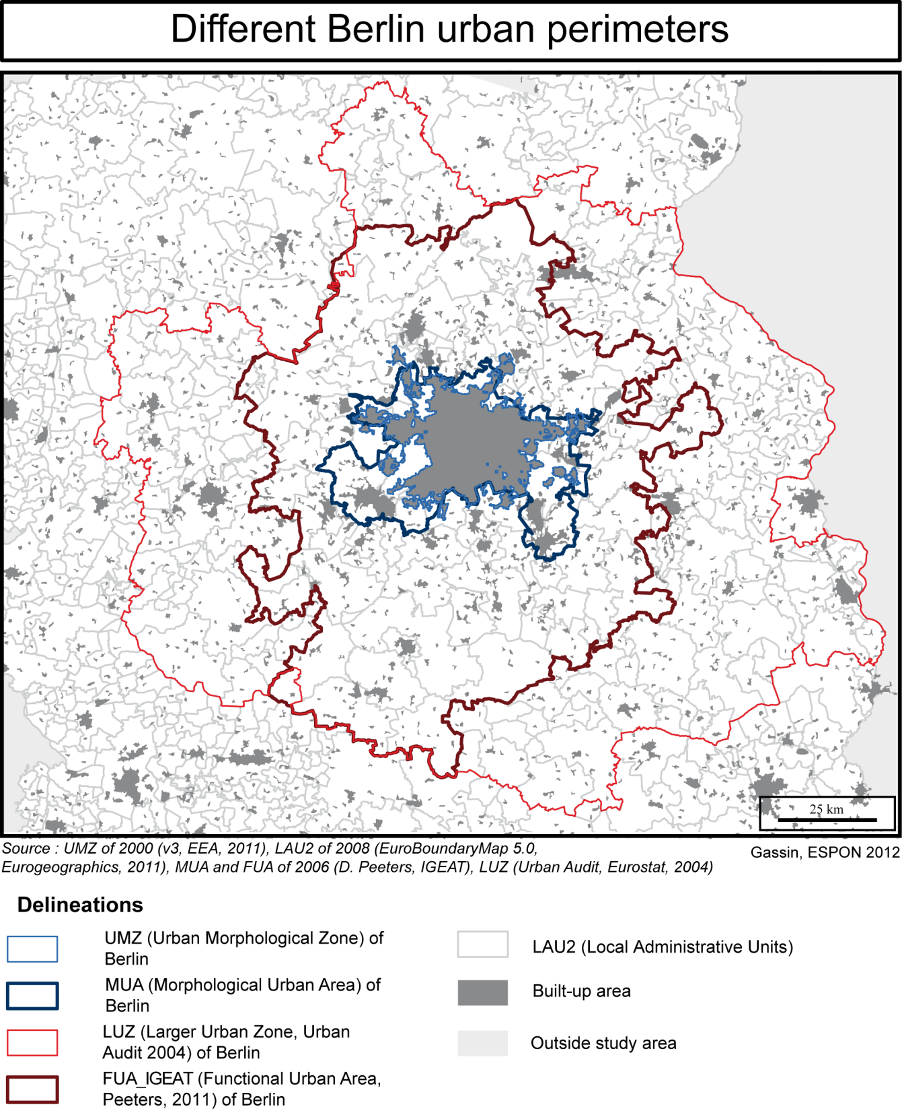
Several urban DB currently available at European scale:
Introduction
How to manage this diversity?
Two works in progress:
Integrating specifications
-Evaluating interoperability
How to enrich the databases?
By agregations from local data
(using a reference level?)

Slide 3
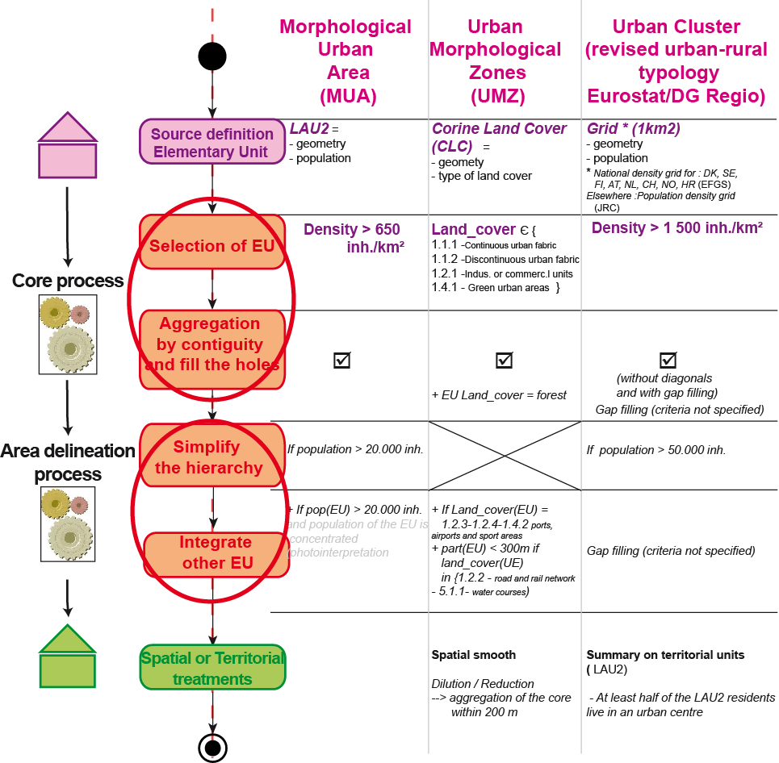
1. Integrating specifications
(morphological DB)
The aim is to formalize the metadata in order to help the users choosing the most appropriate DB regarding their scientific targets
Methods: using same « grammar » to describe the DB and make them more comparable
Results: specificities (sources, parameters) but also strong similarites (construction steps)
Notes:
Placer qqpart l’importance des metadonnées

Slide 4
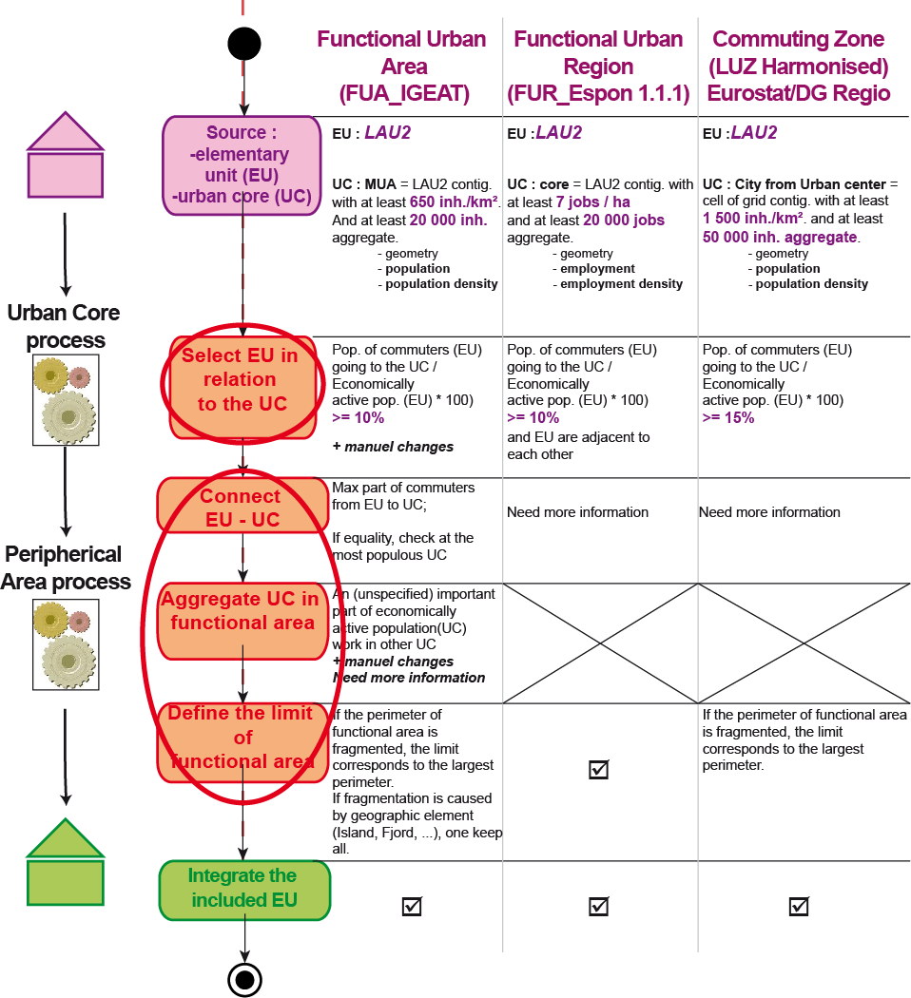
Integrating specifications
(FUA, work in progress)
Methods: same than for morphological areas
Results: specificities (sources for urban core, parameters, the way polycentricity cases are considered) but also strong similarities (construction steps)
Notes:
Placer qqpart l’importance des metadonnées
Peut-on ajouter dans le nom des bases FUA_IGEAT et FUR_???
The limit corresponds to…?

Slide 5
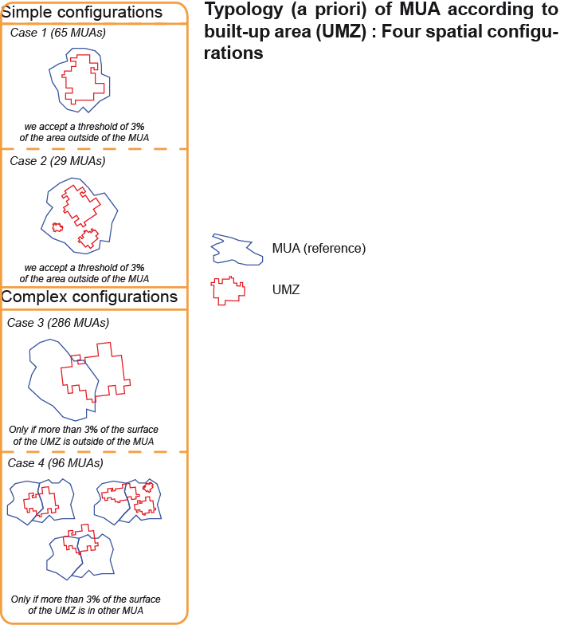
2. Evaluating interoperability between urban DB (degree of compatibility between data)
The aim is to evaluate if we can compare some indicators measured for a city or urban region in the 2 DB, or enrich a DB using the data of another DB
A generic method (here, applied to MUA and UMZ):
a. Defining (a priori) 4 types of overlapping

Slide 6
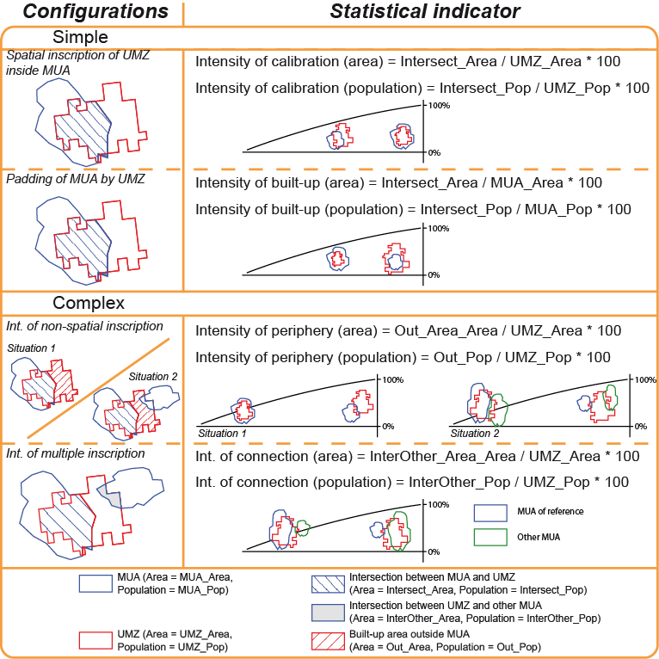
2. Evaluating interoperability between urban DB
b. Defining statistical indicators that can describe these different configurations

Slide 7
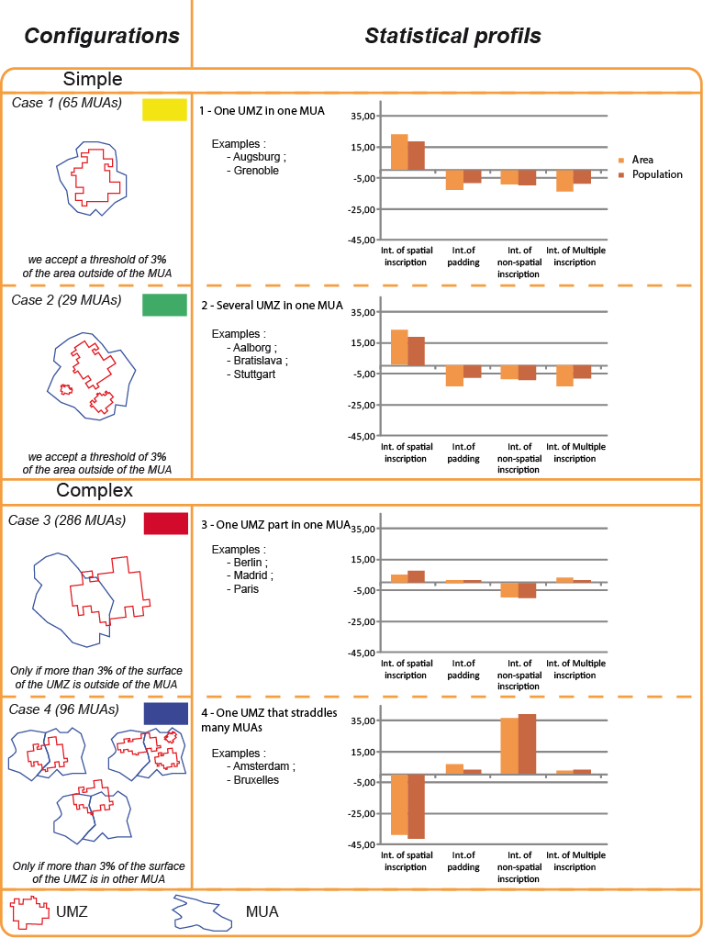
2. Evaluating interoperability between urban DB
Interoperability
c. Testing the sensitivity of the indicators to real configurations of overlapping
(476 MUA > 100 000 inh. And UMZ)
Results:
1) An evaluation of interoperability

Slide 8
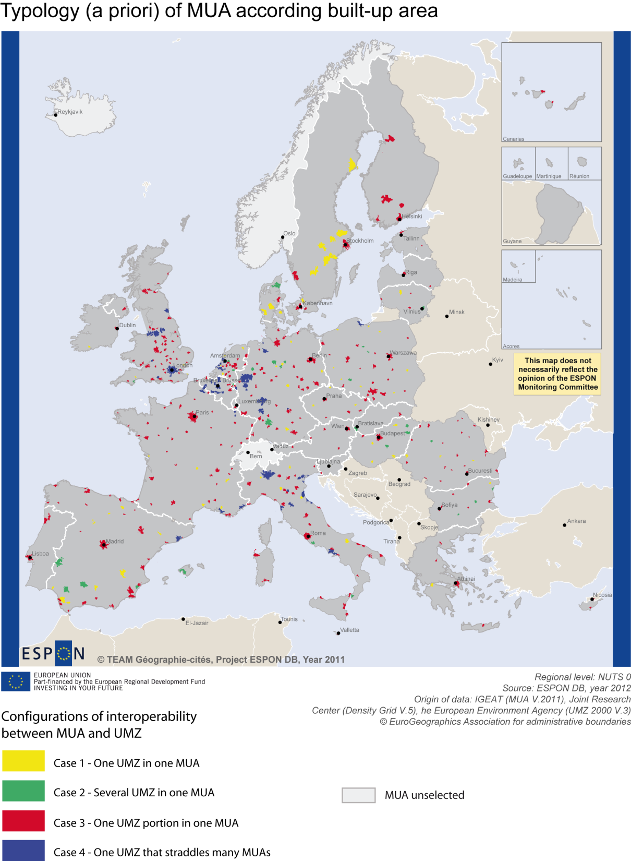


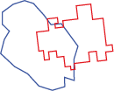
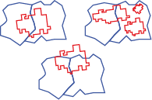
2. Evaluating interoperability between urban DB
Results:
1) An evaluation of interoperability
2) A typology of MUA according to the built-up area patterns
Notes:
Il existe une grande diversité d’approches descendantes en Europe, pour les comprendre on regarde les spécifications. Cette méthode d’intégration est très éclairante. En effet, le résultat montre qu’au final les bases reposent sur des logiques très semblables (construction des cœurs, agrégations autour des cœurs). Peu de choses varient d’une base à une autre.

Slide 9
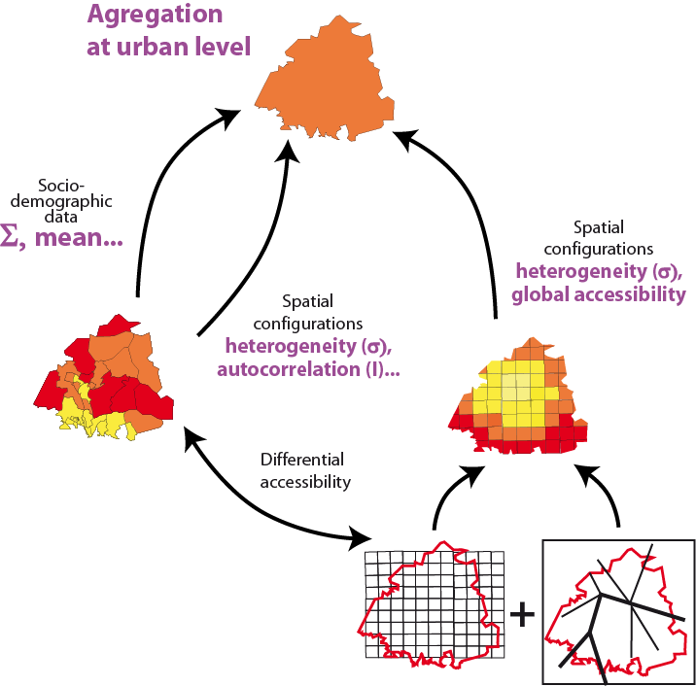
3. How to enrich urban databases?
Agregation of data from local level to the meso-level of the cities:
1) from LAU2 (richness of socio-demographic data): diffential accessibility of blue collars or executives
2) from grid data (fine resolution for environ. , demog. data or other): number of people located at less than half an hour from the city center…
Notes:
Illustration du lien et ouvrir sur les données en local

Slide 10

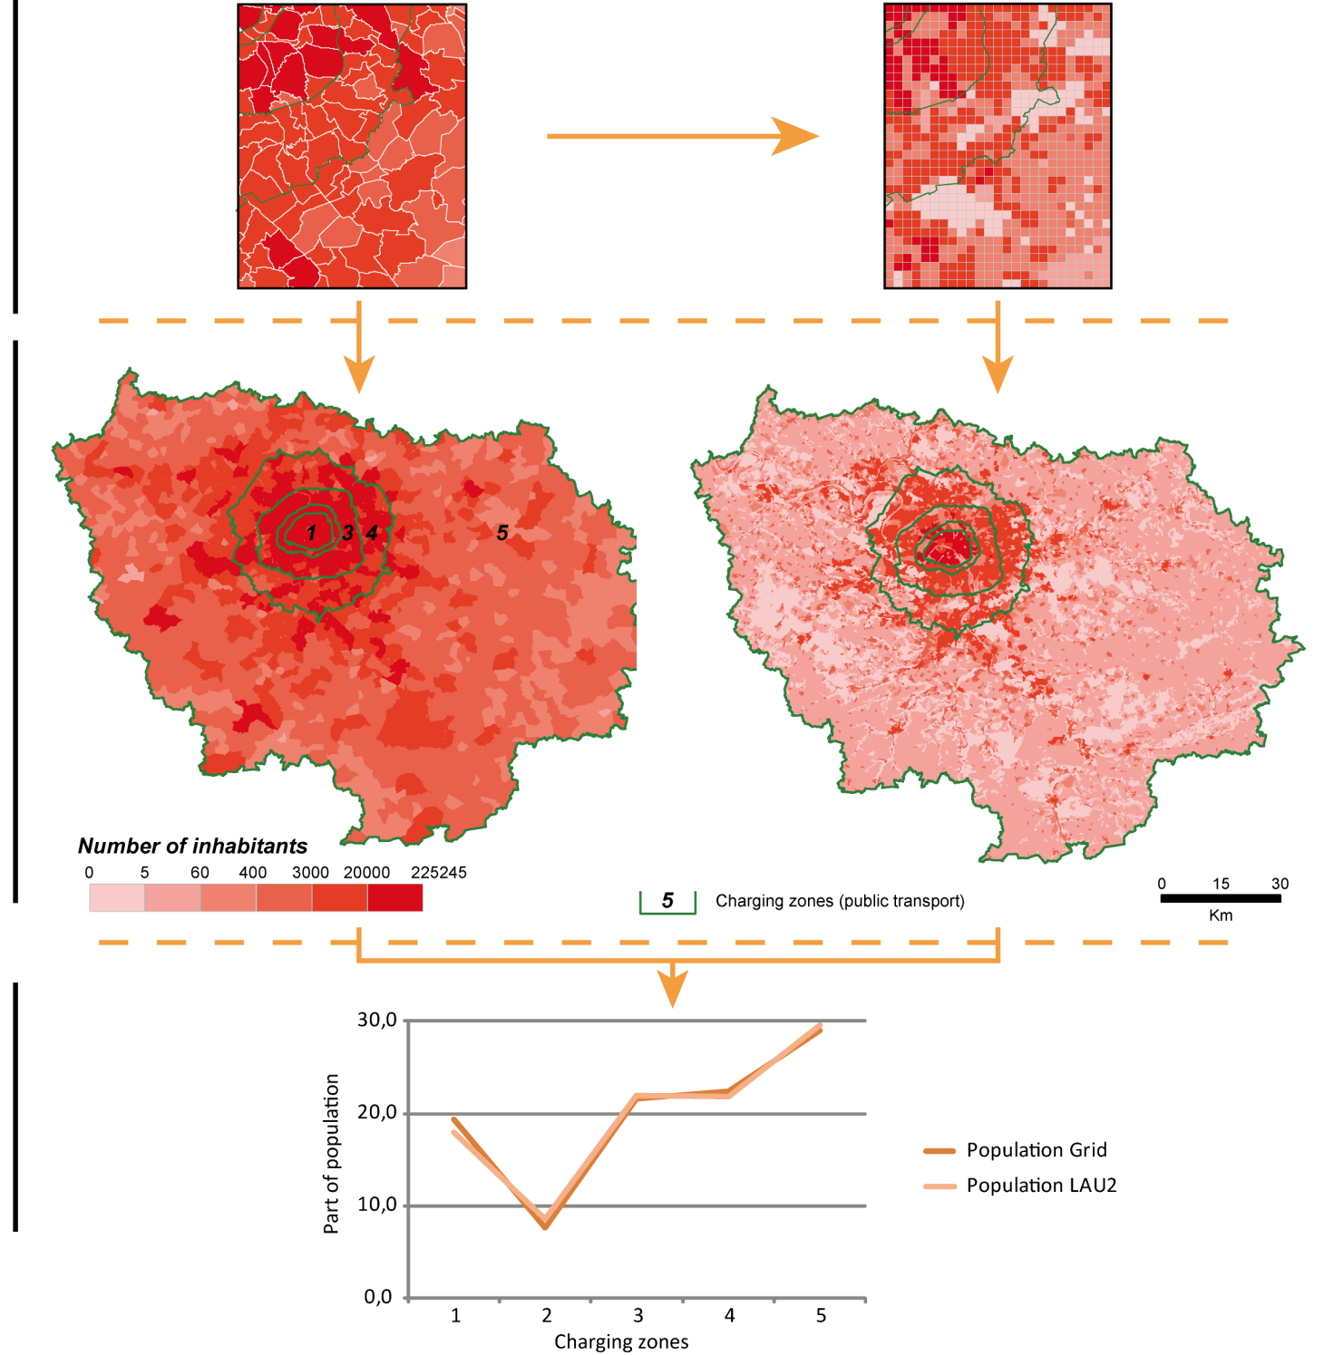
3. How to enrich urban databases?
« Which reference level » depends also on the scale of the study
Local scale: grid is finer and much more accurate
Cost-transportation zones: no real differences
Notes:
Ici résultats sont les mêmes sur les auréoles mais si on s’était intéressé aux zones intra urbaines on aurait vraisemblement plus d’écarts, d’hétérogénité

Slide 11

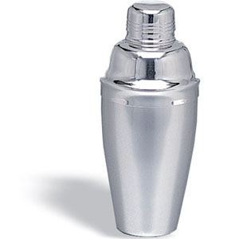

The ESPON Urban OLAP Cube: a tool for combining and analysing heterogeneous urban data
Roger Milego (roger.milego@uab.cat)
Aalborg, ESPON Open Seminar 13-14 June 2012

Slide 12
OLAP technology
OLAP (OnLine Analytical Processing): category of software tools designed to help in the extraction of information from data to support better decision-making.
Multidimensional data model, complex analytical and ad-hoc queries, rapid execution time.
OLAP Cube = some countable variables (measures) such as ha. aggregated by a set of dimensions: spatial (e.g. NUTS regions), thematic (e.g. land cover) and temporal.
An OLAP Cube can be queried online and offline (.CUB file, from MS Excel).

Slide 13
OLAP Cube: A “cocktail” of data

Slide 14
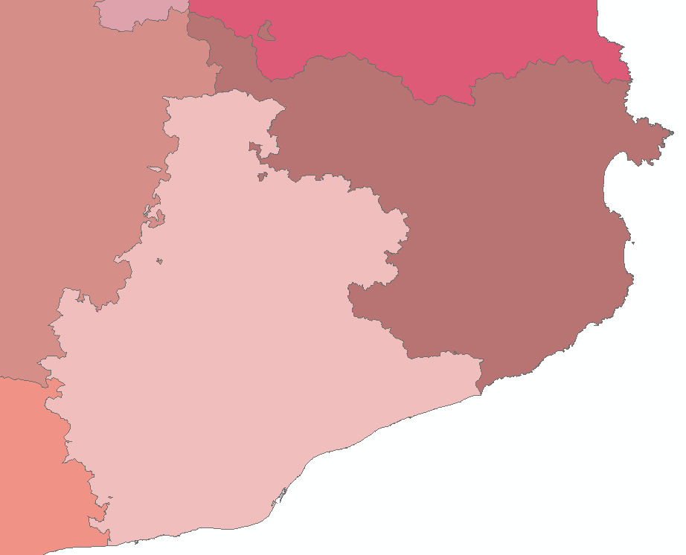

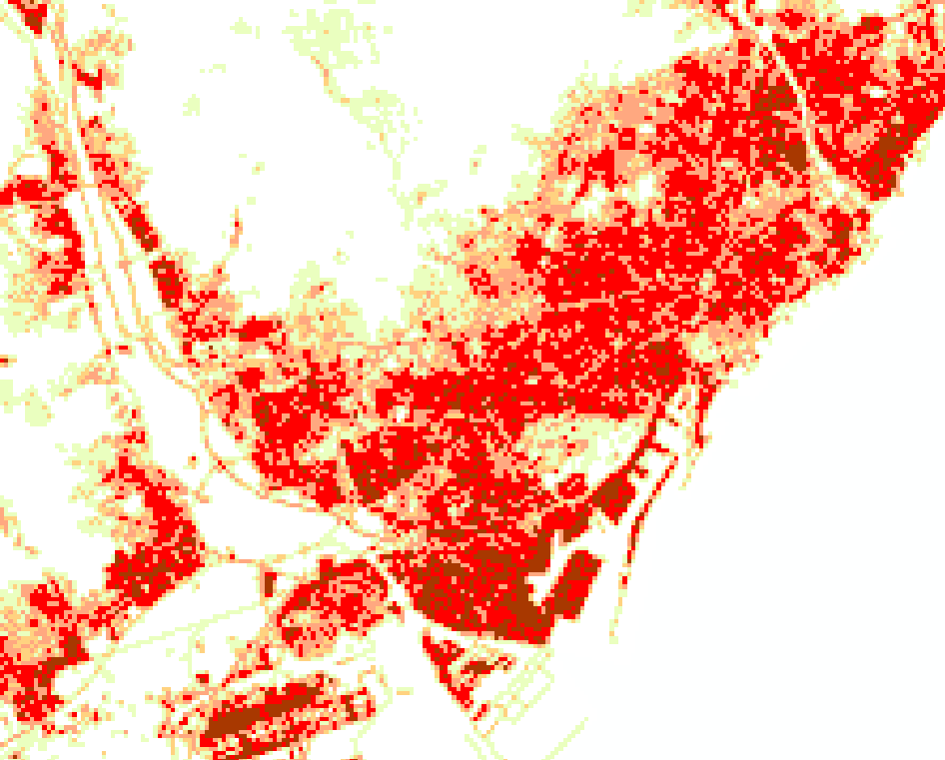
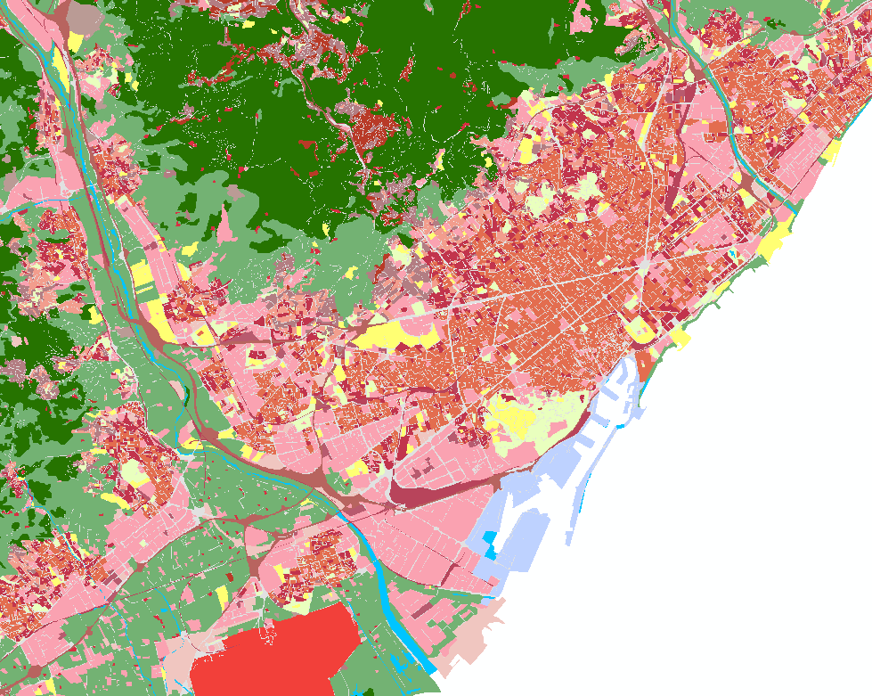
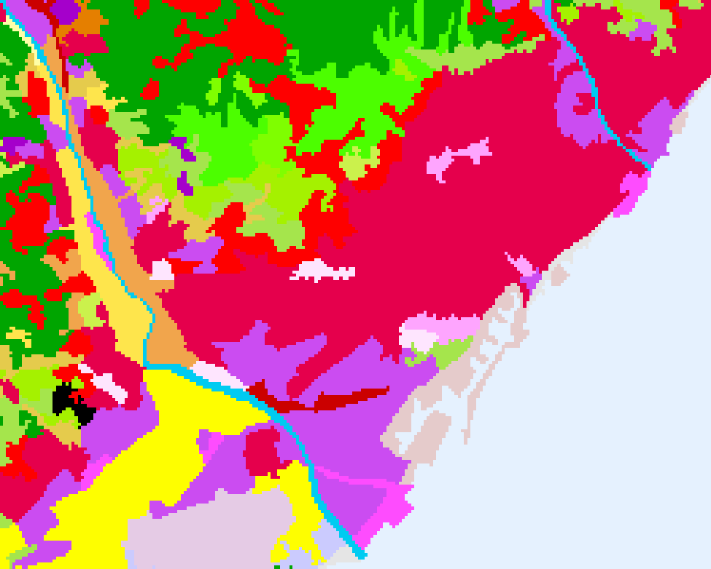
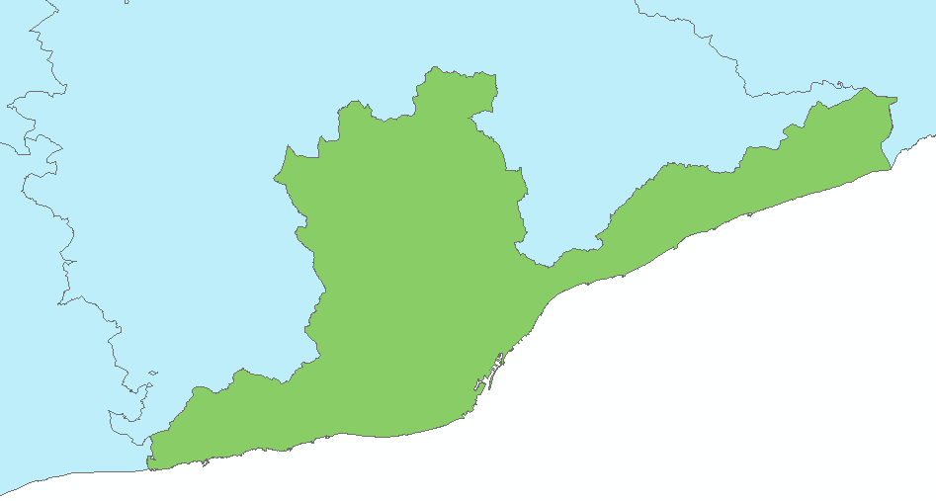
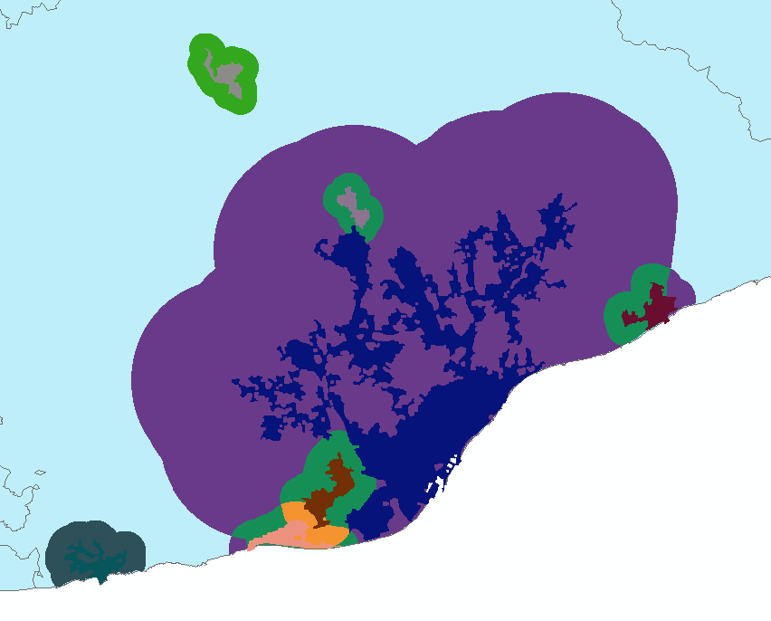
Urban OLAP Cube
100 x 100 m Grid
NUTS
OLAP Cube
OLAP Database
Soil sealing
Urban Atlas
Corine Land Cover
LUZ
SupraUMZ
End Users
Also Protected Sites (N2000+CDDA)
Population figures and Area as measures

Slide 15
Thank you for your attention!
Roger Milego (roger.milego@uab.cat)
Aalborg, ESPON Open Seminar 13-14 June 2012

